Slide 1
Atmosphere Mini Unit
AU2.1: What is the Greenhouse Effect? PRACTICAL
Objective: Students will learn what climate change is and what causes it. Students will complete a hands-on activity to learn about the Greenhouse Effect, how trapped heat in the atmosphere is driving climate change. | Criteria: This lesson will ideally follow on from Topic 1 so that the students have fresh in their mind the difference between climate and weather and the traits of climate, in particular. This lesson will begin to explain what climate change is, and its causes. It will be important for students to have a good grasp on the timescale of climate change
Process: This lesson is a practical designed to showcase how the greenhouse effect works on a small scale. You will begin with 2 jars containing plants and a thermometer, one without a lid and one with a lid (acting as the atmosphere). Temperature inside the jars will be taken over a period by students and noted down. The data will then be converted into a simple graph to help students visualize the differences in temperatures between the 2 jars and a discussion will follow thinking about why this may be and how this could be applicable to our earth and climate change.
Resources: Presentation Activity guide with step-by-step instructions Teacher fact sheet Lesson plan | Notes: Teachers should print out overview of slide show, including the notes for each slide. This will help the lesson flow. The lesson plan can be used in conjunction with the slide show, or the slide show could be used as the plan itself.
Notes:
Lesson Overview
Read over and print off

Slide 2
What is the Greenhouse Effect?
Atmosphere Mini Unit: Topic 2, Lesson 1

Slide 3
AU2.1
Discussion & Results
Introduction
Greenhouse Practical

Slide 4
AU2.1
Introduction

Slide 5
AU2.1
What is the difference between Weather and Climate?
Notes:
Recap from Topic 1, the difference between climate and weather. Reminder that climate changes over longer lengths of time.

Slide 6
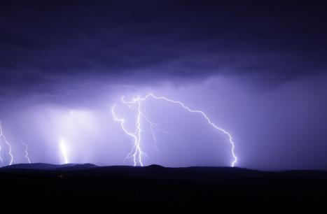
AU2.1
Weather or Climate?
Weather

Slide 7
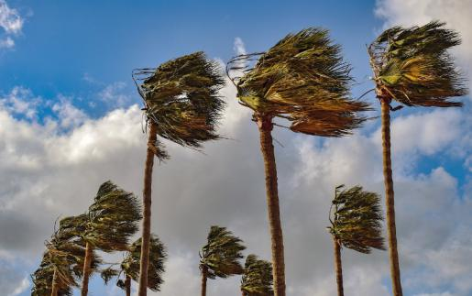
AU2.1
Weather or Climate?
Weather

Slide 8
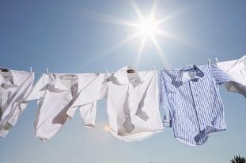
AU2.1
Weather or Climate?
December to April
May to November
Climate

Slide 9
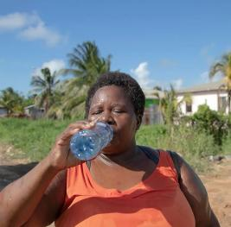
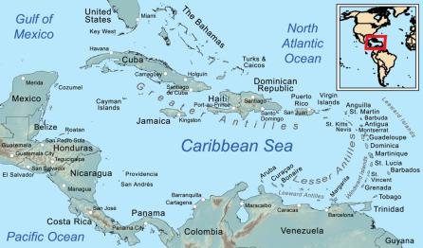
AU2.1
Weather or Climate?
Climate

Slide 10
AU2.1
Greenhouse Practical

Slide 11
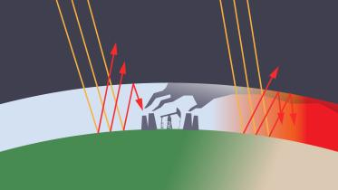
AU2.1
Greenhouse Practical
Method
Assemble your test jars
Take your first temperature measurement and then place in the sun!
Make some predications about what you think will happen
Take temperature at timed intervals throughout the lesson/day
Take your final measurements and discuss your results!
This Photo by Unknown Author is licensed under CC BY
Notes:
Main Activity (45 mins):
Set up your 2 jars with one plant in each.
Add a thermometer to both jars and place a lid on one jar leaving the other jar open.
Take initial temperatures of both jars at the beginning of the activity and get students to make predictions about what will happen to the temperature at the end of the activity.
Continue to take measurements at regular intervals throughout and then a final temperature at the end.
It is expected that the jar with the lid will be warmer than the jar without the lid. The rise in temperature will demonstrate the ‘trapping’ nature of the lid and in a similar way that increased CO2 in our atmosphere is increasing the greenhouse effect.

Slide 12
AU2.1
Discussion & Results

Slide 13
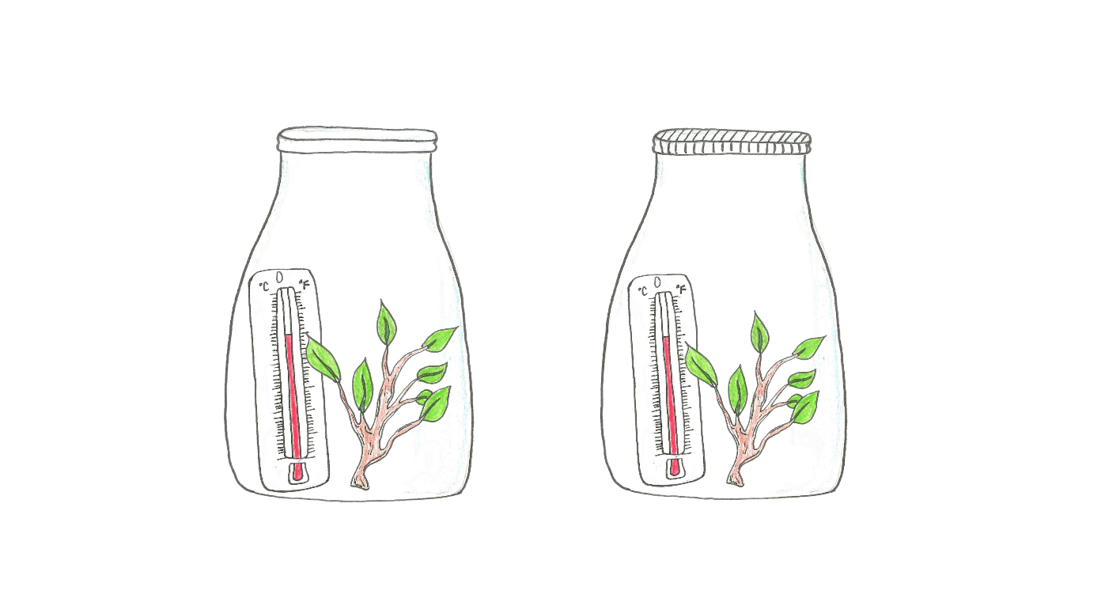
AU2.1
Discussion & Results
Did the results match your predictions?
Why did the jar with the lid show higher temperatures then the jar without one?
Notes:
Conclusion (15 mins):
Discuss what has happened with the two jars.
Ask the students if their predictions were accurate.
Use the data collected by the students to create a simple graph to help student visualize the differences in data between the 2 jars.
Discuss why they think the jar with the lid was warmer than the jar without.
Encourage students to go home and talk about this with their parents or caregivers.

Slide 14
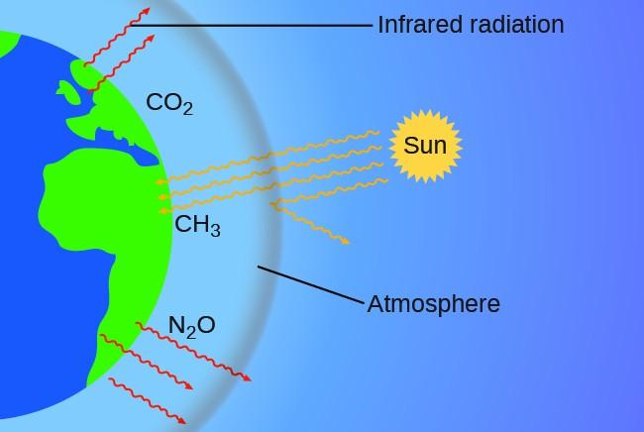
AU2.1
This Photo by Unknown Author is licensed under CC BY
Notes:
The next lesson will go deeper into understanding The Greenhouse Effect in a climate change context so this explanation does not need to be deep and can be done in simple terms.

Slide 15
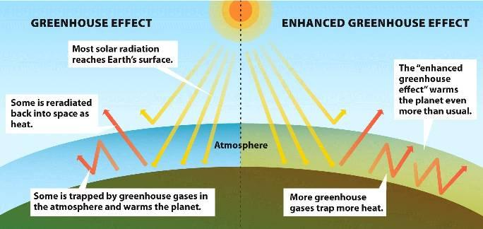
AU2.1
This Photo by Unknown Author is licensed under CC BY
Notes:
The Greenhouse Effect is a natural phenomenon, so in the case of climate change, they would refer to it as the Enhanced Greenhouse Effect that is causing the earth to warm faster and more then usual.
The next lesson will go deeper into understanding The Greenhouse Effect in a climate change context so this explanation does not need to be deep and can be done in simple terms.

