Slide 1
Atmosphere Mini Unit
AU2.2: How are Human Activities Amplifying the Greenhouse Effect's Impact on Earth's Systems?
Objective: Students understand the effects of CO2 on the greenhouse effect. Students understand the sources of CO2 from the burning of fossil fuels and the ever-increasing demand for energy. Students understand that increased heat will affect all the different biomes and climate zones on Earth | Criteria: Drawing on the last lesson, it is explained that the glass jar represents the greenhouse effect which is caused by carbon dioxide in the atmosphere. It is explained that carbon dioxide is added to the atmosphere by burning fossil fuels because humans use energy for many of the things that they do. CO2 in the atmosphere = more heat and energy in the system.
Process: What do we use energy for? Students discuss energy use in their homes, transport, food, consumer goods - they identify what energy is being used and where it comes from. Using a climate map of the world in conjunction with a vegetation map, as a class they are asked what will happen in a warmer world in all the different regions (Polar, Subpolar, Temperate, Subtropical, Tropical) alongside (Ice, Tundra, Forests, Steppe, Savannah, Tropics, Desert). This will need to be done with pictures, so that children can think about the effects of heat on these different areas of landscape and vegetation.
Resources: Presentation Lesson plan Activity Sheets with different time zones YouTube Video | Notes: Teachers should print out overview of slide show, including the notes for each slide. This will help the lesson flow. The lesson plan can be used in conjunction with the slide show, or the slide show could be used as the plan itself.

Slide 2
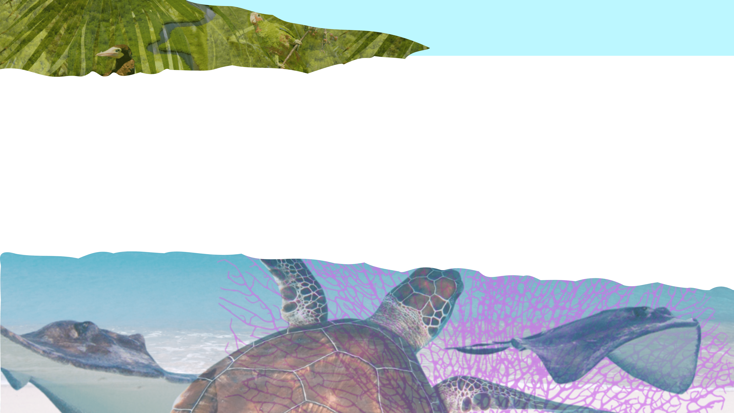
How are Human Activities Amplifying the Greenhouse Effect's Impact on Earth's Systems?
Atmosphere Mini Unit: Topic 2, Lesson 2

Slide 3
AU2.2
Our
atmosphere
Energy around us
Introduction
Getting warmer
Climate Zone Activity
Conclusion

Slide 4
AU2.2
Introduction

Slide 5
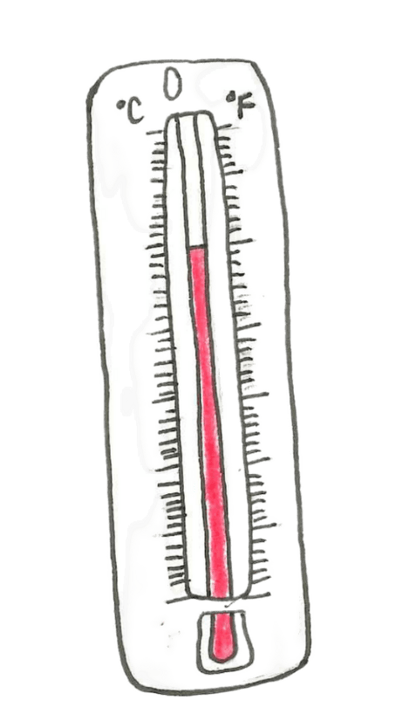
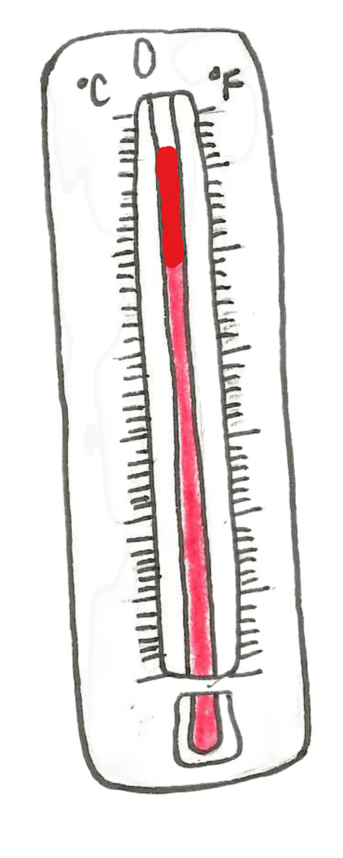
AU2.2
What happened to the temperatures of the jars in our last lesson?
Why do you think that happened?
Jar with lid
Jar without lid
Notes:
Think, Pair, Share - if never used this activity before then explain it and model it. Children think independently for 15 seconds, talk with a partner for 30 seconds, and then some answers are shared with the class. Do a brief recap of the experiment in the last lesson and illicit the answer that the jar with the lid on became warmer because the lid trapped the heat and acted as an insulator.

Slide 6
AU2.2
What did we learn about the jars?

Slide 7
AU2.2
What did we learn about the jars?
If the jars are like planet Earth, what might it tell us about what is happening to our climate?

Slide 8
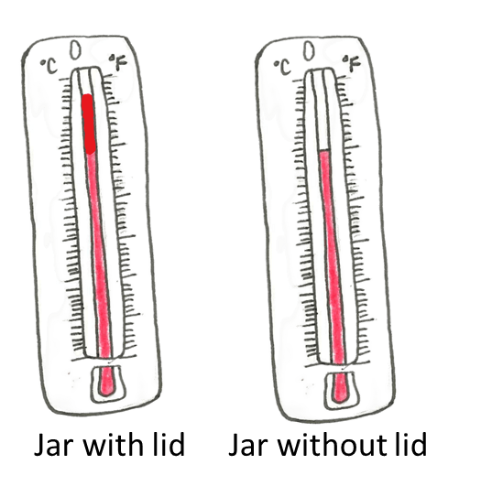
AU2.2
In the experiment:
The jar with the lid got warmer

Slide 9
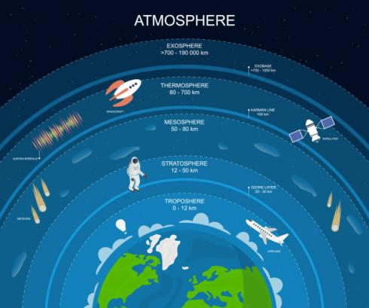
AU2.2
The lid acted like the atmosphere on the Earth

Slide 10
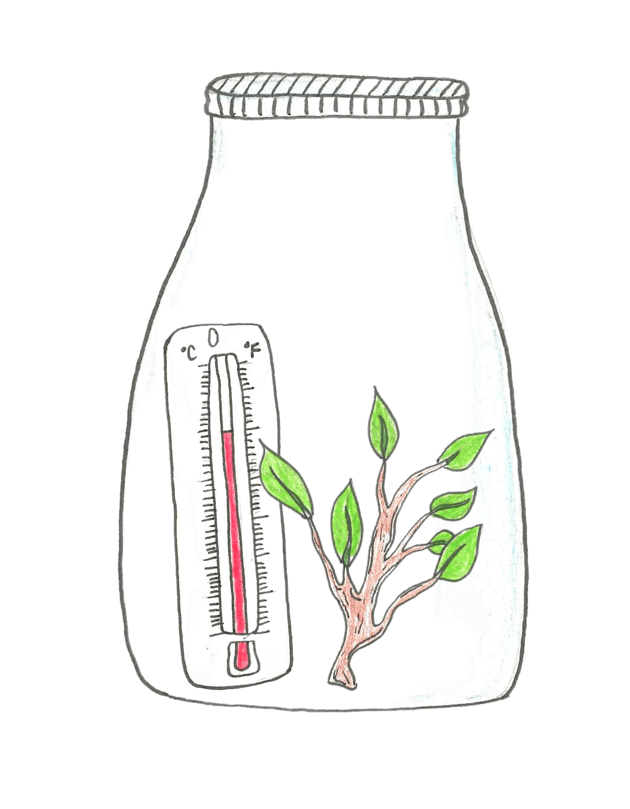
AU2.2
The lid acted like the atmosphere on the Earth

Slide 11
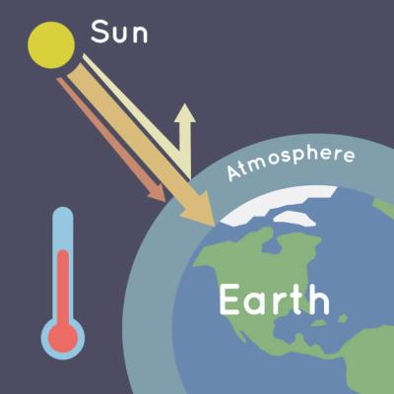
AU2.2
The atmosphere is like a blanket that keeps the Earth warm.

Slide 12
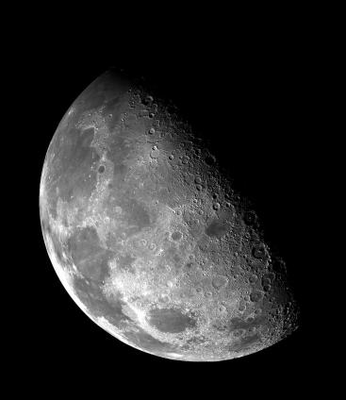
AU2.2
Without the atmosphere, the Earth would be too cold for any life to form – like the moon!

Slide 13
AU2.2
Our atmosphere

Slide 14
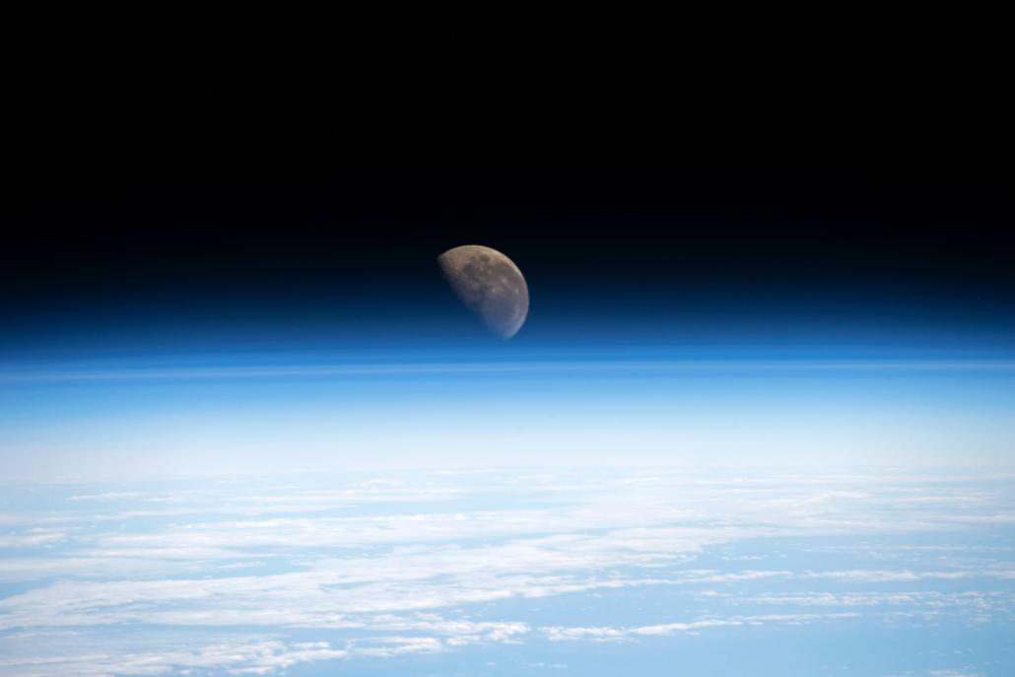
AU2.2
Our atmosphere
Notes:
Think, Pair, Share - if never used this activity before then explain it and model it. Children think independently for 15 seconds, talk with a partner for 30 seconds, and then some answers are shared with the class. Do a brief recap of the experiment in the last lesson and illicit the answer that the jar with the lid on became warmer because the lid trapped the heat and acted as an insulator.

Slide 15
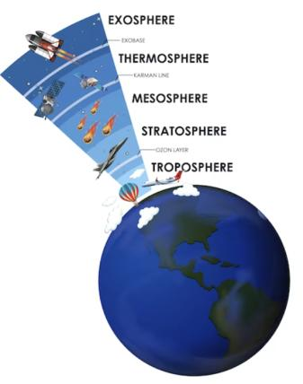
AU2.2
The Earth is surrounded by a blanket of gases called the atmosphere
Notes:
Briefly explain that Earth doesn’t have a ‘lid’ but it has an atmosphere made up of gases that trap heat and create an environment that is like Goldilocks - ‘just right’ - for life.
This can be broad and general and doesn’t need much explanation beyond what is on the slides.

Slide 16
AU2.2
It extends nearly 400 miles from the surface of the Earth.
Notes:
Think, Pair, Share - if never used this activity before then explain it and model it. Children think independently for 15 seconds, talk with a partner for 30 seconds, and then some answers are shared with the class. Do a brief recap of the experiment in the last lesson and illicit the answer that the jar with the lid on became warmer because the lid trapped the heat and acted as an insulator.

Slide 17
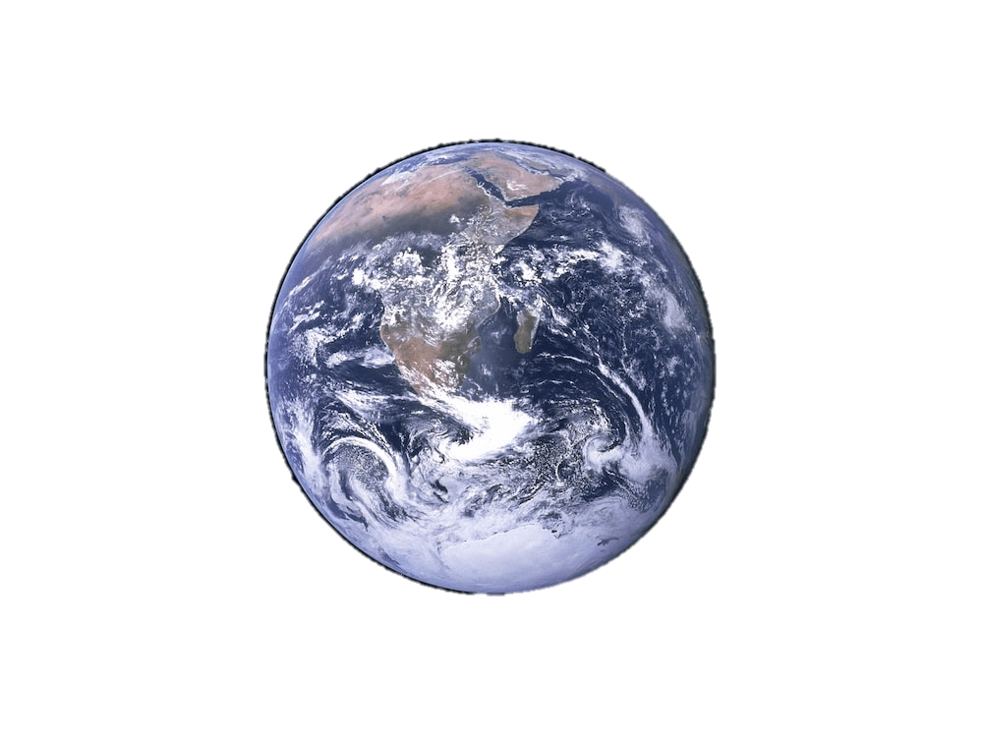
AU2.2
The atmosphere absorbs energy from the sun, recycles water and is made up of gases in amounts that give us a moderate climate.
Notes:
Think, Pair, Share - if never used this activity before then explain it and model it. Children think independently for 15 seconds, talk with a partner for 30 seconds, and then some answers are shared with the class. Do a brief recap of the experiment in the last lesson and illicit the answer that the jar with the lid on became warmer because the lid trapped the heat and acted as an insulator.

Slide 18
AU2.2
It keeps our earth not too hot, not to cold but...
Just right!
Notes:
Think, Pair, Share - if never used this activity before then explain it and model it. Children think independently for 15 seconds, talk with a partner for 30 seconds, and then some answers are shared with the class. Do a brief recap of the experiment in the last lesson and illicit the answer that the jar with the lid on became warmer because the lid trapped the heat and acted as an insulator.

Slide 19
AU2.2
The layers of the atmosphere act like a blanket to protect and insulate the Earth
You can even see it from space!
Notes:
Think, Pair, Share - if never used this activity before then explain it and model it. Children think independently for 15 seconds, talk with a partner for 30 seconds, and then some answers are shared with the class. Do a brief recap of the experiment in the last lesson and illicit the answer that the jar with the lid on became warmer because the lid trapped the heat and acted as an insulator.

Slide 20
AU2.2
Life on Earth depends on our atmosphere…
Notes:
Show video.
Avoid discussing too many technical details. Only want the big-picture stuff.

Slide 21
AU2.2
Energy around us

Slide 22
AU2.2
Our atmosphere is changing
By using a lot of ENERGY, we are adding gasses to the atmosphere and those gases help to trap in the heat that makes Earth warmer.
Can you think of some things that use energy everyday?
Notes:
Children think independently for 15 seconds, talk with a partner for 30 seconds, and then some answers are shared with the class. It might be worth writing down a few of their ideas on the class whiteboard.

Slide 23
AU2.2
Let’s think about energy for a minute.
With your neighbor, come up with a list of 5 ways we use energy everyday.
Notes:
Children think independently for 15 seconds, talk with a partner for 30 seconds, and then some answers are shared with the class.

Slide 24
AU2.2
Now we will look at some pictures and identify where energy is being used…
Notes:
This should be a very quick-fire tour through the slides. It should take no longer than 5 minutes to go through all the slides.
It would be best if the teacher handed control of the presentation to a pupil who can change slides on the teacher’s request.
The teacher should be writing all the answers on the class whiteboard and asking questions - some could be call-outs, some directed at specific pupils, some could be ‘thinking time’ of 5 seconds and asking either the number or type of energy uses.
The punchline here is: we use energy for everything all the time - to keep warm, to keep cool, for our food, our homes, our travel etc…

Slide 25
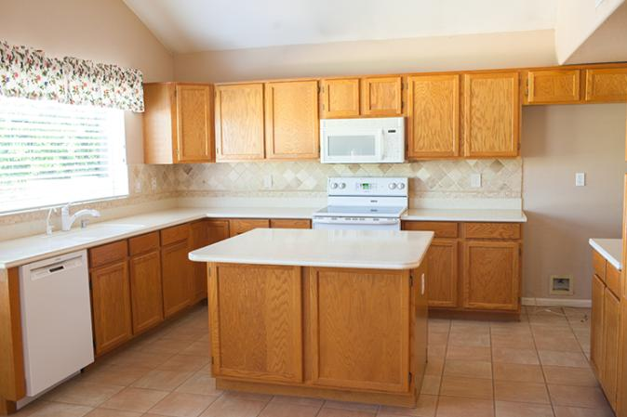
AU2.2
What is using energy?
What other things in our homes
use energy?

Slide 26
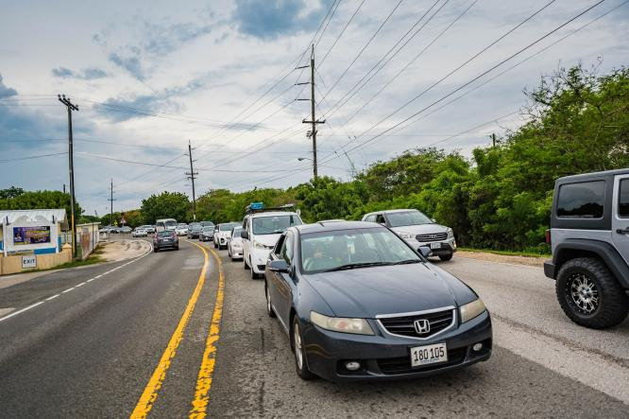
AU2.2
What is using energy?

Slide 27
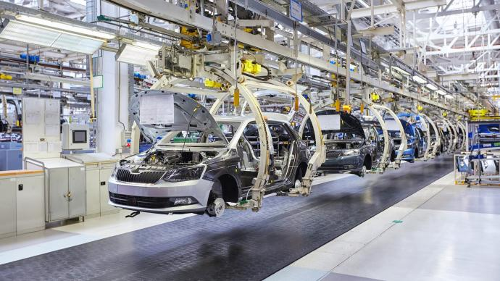
AU2.2
What is using energy?

Slide 28
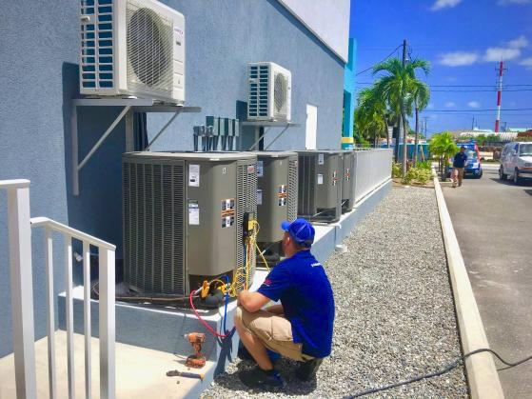
AU2.2
What is using energy?

Slide 29
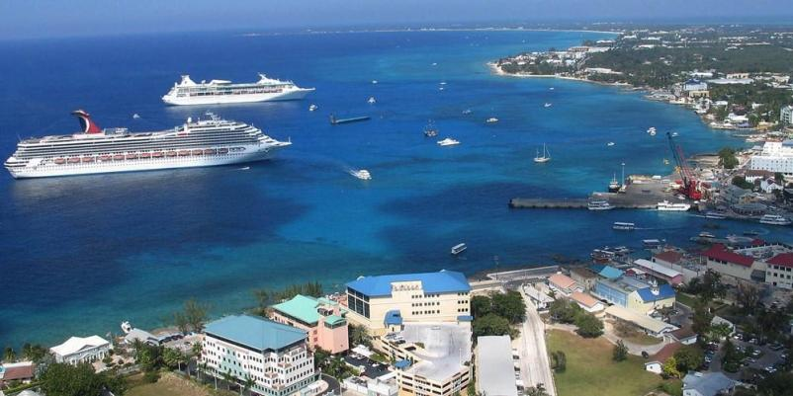
AU2.2
What is using energy?

Slide 30
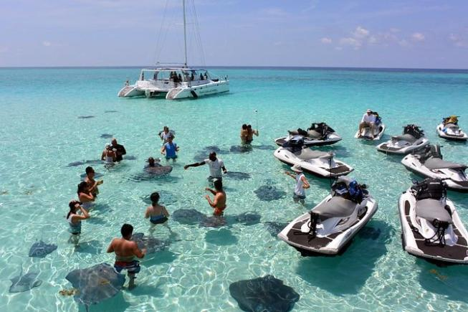
AU2.2
What is using energy?

Slide 31
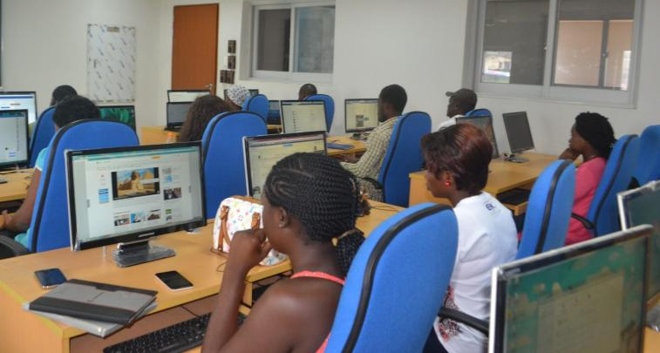
AU2.2
What is using energy?

Slide 32
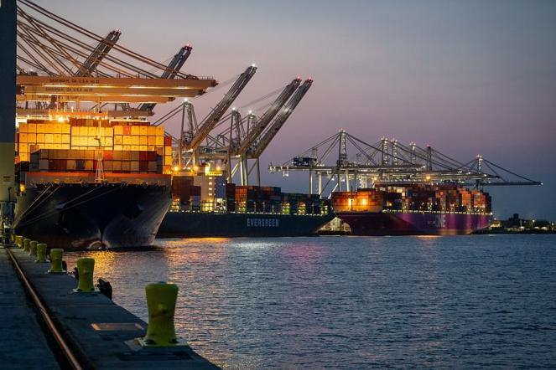
AU2.2
What is using energy?

Slide 33
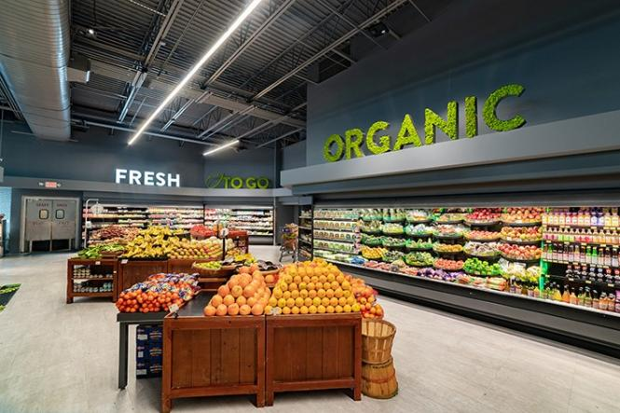
AU2.2
What is using energy?
How was it grown? How did it get here?

Slide 34
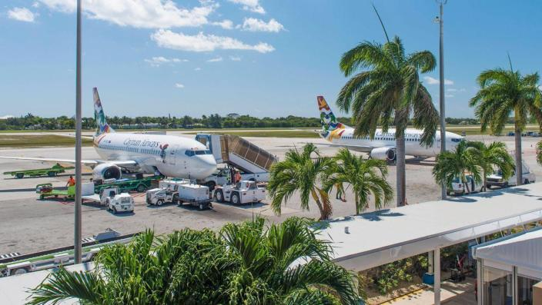
AU2.2
What is using energy?

Slide 35
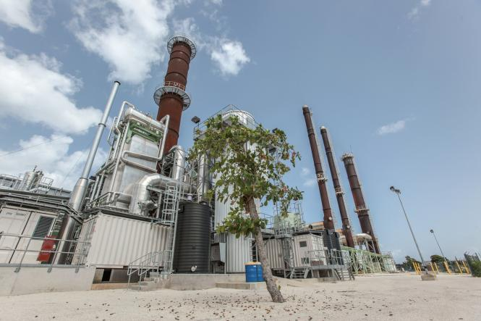
AU2.2
What is using energy?

Slide 36
AU2.2
We use a LOT of energy

Slide 37
AU2.2
We use a LOT of energy
A lot of our energy comes from burning FOSSIL FUELS (coal, oil, gas)
By burning these fossil fuels, we are adding gases to the atmosphere
These gases are trapping in the heat just like the lid on the jars which makes our atmosphere hotter.
Notes:
Teacher to go through each of the bullet points one at a time - get a pupil to read them out to the class. There could be some questions here to link back to the earlier video. What do you remember? Gases? Greenhouse effect etc?
Teacher to explain that our atmosphere is changing, is warming and that it is the gases from burning fossil fuels that make this happen - link back to why do we burn fossil fuels? Because we use so much ENERGY.

Slide 38
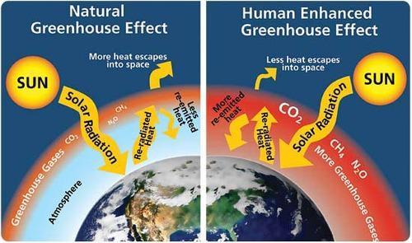
AU2.2
Our energy use is causing the world to heat up.
Notes:
Very brief mention here - it is a picture of the situation changing. Stress the ‘HUMAN ENHANCED’ greenhouse Effect - it is a naturally phenomena that is being accelerated by us. There has always been a greenhouse effect, but it is becoming a hothouse because of human actions…

Slide 39
AU2.2
Our atmosphere is changing
This will affect everything on the planet.
Can you explain what might happen to animals and plants if the Earth gets warmer?
Notes:
Think / pair / share:
Children think independently for 15 seconds, talk with a partner for 30 seconds, and then some answers are shared with the class. If the only thing that happens is children say, ‘this is bad because animals will have to move and plants can’t move’ that is quite enough.

Slide 40
AU2.2
Our atmosphere is changing
We will look at some pictures of different places and environments on Earth and for each one, we will ask what will happen if the world gets warmer.
Notes:
Think / pair / share:
Children think independently for 15 seconds, talk with a partner for 30 seconds, and then some answers are shared with the class. If the only thing that happens is children say, ‘this is bad because animals will have to move and plants can’t move’ that is quite enough.

Slide 41
AU2.2
Getting warmer
Notes:
Where is Cayman? What are the different zones? Just elicit that there are hotter and colder, wetter and drier places on the planet.

Slide 42
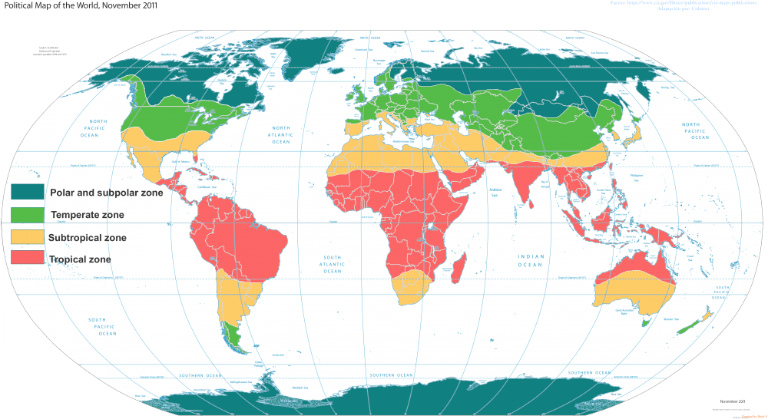
AU2.2
The world has many climate ‘zones’.
Where is Cayman?
Notes:
Where is Cayman? What are the different zones? Just elicit that there are hotter and colder, wetter and drier places on the planet.

Slide 43
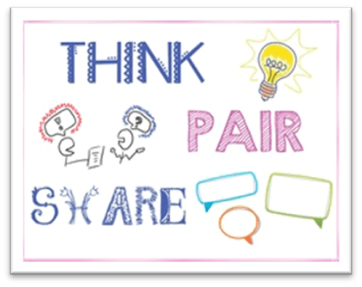
AU2.2
What could you say about each zone?
Notes:
Take some answers. Draw out answers that stress temperature, closeness to poles or equator and possibly precipitation.

Slide 44
AU2.2
What could you say about each zone?
Notes:
Take some answers. Draw out answers that stress temperature, closeness to poles or equator and possibly precipitation.

Slide 45
AU2.2
Climate Zone Activity

Slide 46
AU2.2
Your turn!
You will work in fours (two pairs)
You will get a sheet with a climate zone for your group
Look at the pictures and read the facts
Think about the habitat, animals and plants
Discuss the questions in your group
What do you think?
Try to answer them!
Notes:
Get children to read through the slide. Tell them that you will leave it up on the board. Put the children in groups of four. Hand out the sheets - one per group.

Slide 47
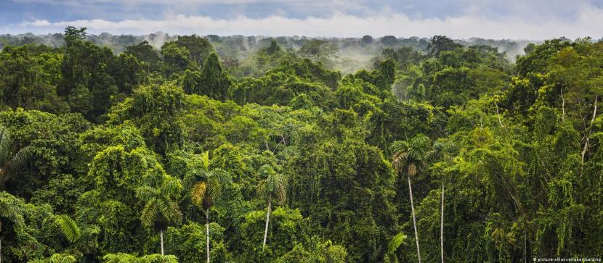
AU2.2
What might happen here in a warmer world?
Notes:
For the next slides - whizz through these. What ‘climate zone’ is it in? Use the four zones that the kids have just worked on. Accept that some photos could be more than one zone.
No need to identify the habitats / biomes, but you could.
Ask for suggestions - take them all and try not to comment too much - this is an exercise in asking the children what they think might happen. Remember that more heat doesn’t always mean drier - you might want to stress that the rainfall might get stronger too. The energy in the system is driving climate change and extreme weather. Perhaps ask questions about what will the affect be on the habitat, and then link that to plants and animals - take some examples.

Slide 48
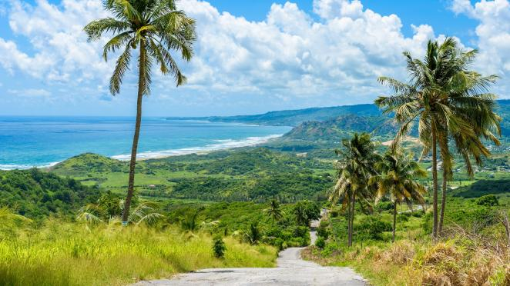
AU2.2
What might happen here in a warmer world?

Slide 49
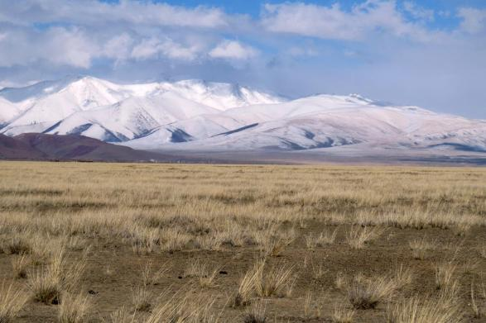
AU2.2
What might happen here in a warmer world?

Slide 50
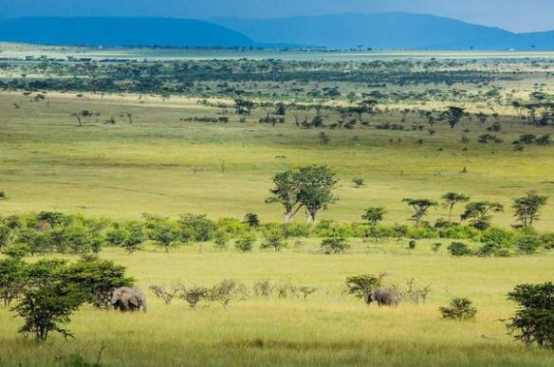
AU2.2
What might happen here in a warmer world?

Slide 51
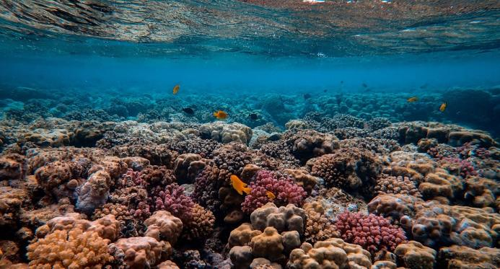
AU2.2
What might happen here in a warmer world?

Slide 52
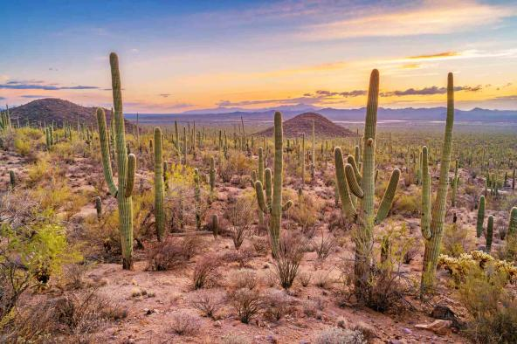
AU2.2
What might happen here in a warmer world?

Slide 53
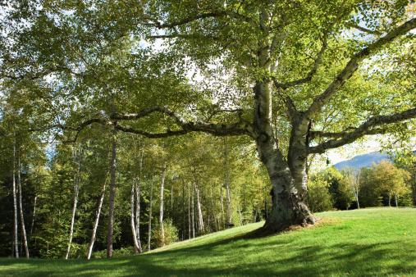
AU2.2
What might happen here in a warmer world?

Slide 54
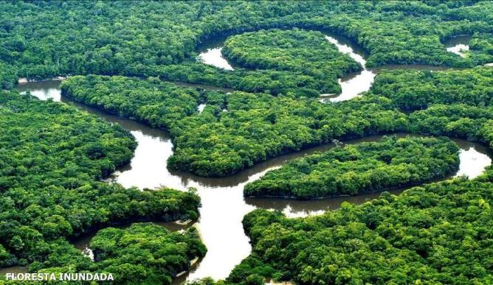
AU2.2
What might happen here in a warmer world?

Slide 55
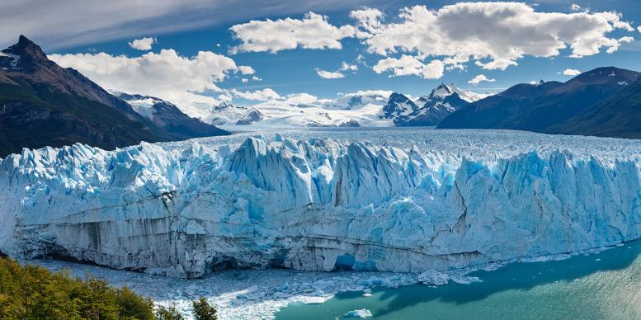
AU2.2
What might happen here in a warmer world?

Slide 56
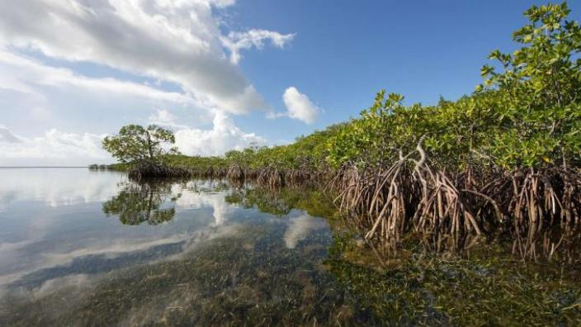
AU2.2
What might happen here in a warmer world?

Slide 57
AU2.2
Conclusion

Slide 58
AU2.2
What about you?
What questions did this lesson make you think of?
How do you FEEL after learning about this?
What does this lesson make you want to DO?
Notes:
End of lesson.
Ask for their thoughts and feelings. Allow the negative ones, but you might want to inject some hope by suggesting action if it is too gloomy.
However, don’t shut down or contradict any sad feelings. Leave it with the idea that we can learn more about our climate and world and that will help us better protect it through our actions and our voices.

Slide 59
AU1.1

