Slide 1
Atmosphere Mini Unit
AU2.3: How does climate change affect the oceans?
Objective: Students will understand how climate change is affecting the oceans. Students will explore the concepts of ocean acidification, temperature change and sea level rise. Students will reflect on the ways this may impact the Cayman Islands. | Criteria: In the last lessons we covered what the Greenhouse Effect is and how we as humans are contributing to it through extreme energy use. It will be important students understand the concept of there being more CO2 in the atmosphere then there normal.
Process: Students will be given handouts and carry out 3 different demonstrations highlighting the effects of climate change on the ocean: sea level rise, temperature change and ocean acidification. Each of these demonstrations will be practical’s and can be completed in one lesson. After the demonstrations are over, students will complete the ‘what happened’ segment of the handout and contemplate their results.
Resources: 3-part presentation Lesson plan Activity handout Activity breakdown and materials list Teacher Fact Sheet Optional extension ocean acidification activity sheet | Notes: Teachers should print out overview of slide show, including the notes for each slide. This will help the lesson flow. The lesson plan can be used in conjunction with the slide show, or the slide show could be used as the plan itself.

Slide 2
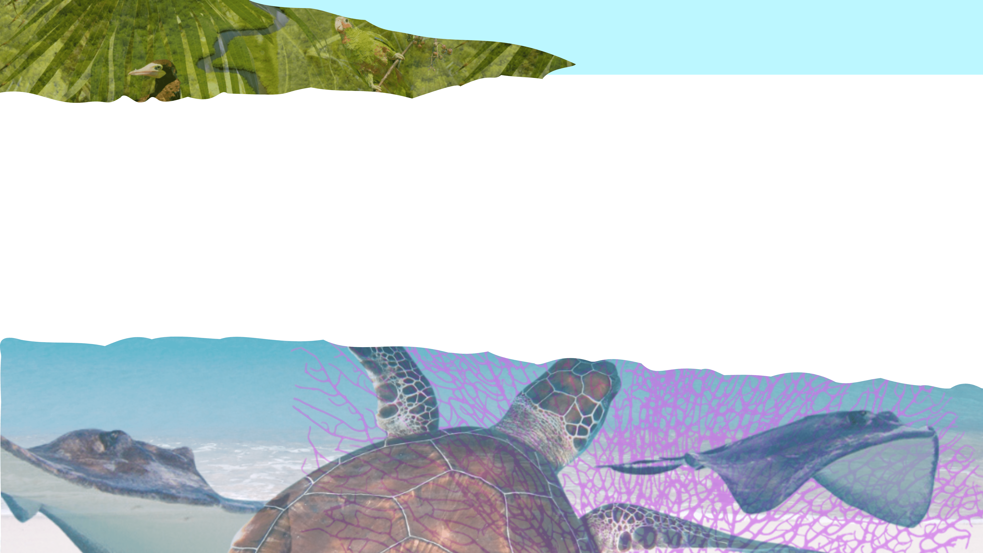
How does climate change affect the oceans?
Atmosphere Mini Unit: Topic 2, Lesson 3

Slide 3
AU2.3
Temperature Change
Sea Level Rise
Introduction
Ocean Acidification
Results & Discussion
Notes:
This presentations has the instructions for 3 different demonstrations and follows the suggested order for the demonstrations.
Temperature Change
Sea Level Rise
Ocean Acidification
These will require some setting up before hand, so make sure you have the right materials and reference the demonstration guide before hand. You are also welcome to have the students set up these experiments themselves if you have time.

Slide 4
AU2.3
Introduction
Notes:
Explain to students that they will be conducting demonstrations to observe the effects of climate change on ocean temperatures and sea level rise.

Slide 5
AU2.3
How does climate change affect the oceans?
Notes:
Ask students to think about this questions silently for a minute or so to think of a few ways in which it may affect the oceans and then have them put their hands up to give their guesses.

Slide 6
AU2.3
How does climate change affect the oceans?
Temperature change
Sea Level rise
Ocean acidification
Notes:
These are the 3 main effects on the ocean that they will be learning about during this presentation.

Slide 7
AU2.3
What do you know about how this may affect the ocean?
Temperature Change
How might this affect the Cayman Islands?
Notes:
Complete think-pair-share in regard to this question and then ask them to think about how it may affect Cayman, this can be hypothetical as they will be coming back to answer this on the handout. (3mins)

Slide 8
AU2.3
What do you know about how this may affect the ocean?
Sea Level rise
How might this affect the Cayman Islands?
Notes:
Complete think-pair-share in regard to this question and then ask them to think about how it may affect Cayman, this can be hypothetical as they will be coming back to answer this on the handout. (3mins)

Slide 9
AU2.3
What do you know about how this may affect the ocean?
Ocean acidification
How might this affect the Cayman Islands?
Notes:
Complete think-pair-share in regard to this question and then ask them to think about how it may affect Cayman, this can be hypothetical as they will be coming back to answer this on the handout. (3mins)

Slide 10
AU2.3
Activity time!
The activity sheet in front of you has 3 columns:
Predictions, What happened and How will it affect Cayman.
Notes:
Distribute the handout with these 3 columns. You will see that there is a harder version and an easier version. The harder version requires students to write their thoughts in complete sentences and the easier version is where students can draw their thoughts/ bullet point.

Slide 11
AU2.3
Activity time!
Predictions – This is where you will write or draw what you think will happen
Notes:
Take them through what is expected of each column, so they know how to answer

Slide 12
AU2.3
Activity time!
Predictions – This is where you will write or draw what you think will happen
What Happened? – what happened at the end of the demonstration?
Notes:
Take them through what is expected of each column, so they know how to answer

Slide 13
AU2.3
Activity time!
Predictions – This is where you will write or draw what you think will happen
What Happened? – what happened at the end of the demonstration?
How will it affect Cayman? – How do you think the effects of this demonstration might affect our home?
Notes:
Take them through what is expected of each column, so they know how to answer

Slide 14
AU2.3
Activity time!
Predictions – This is where you will write or draw what you think will happen
What Happened? – what happened at the end of the demonstration?
How will it affect Cayman? – How do you think the effects of this demonstration might affect our home?
Notes:
Take them through what is expected of each column, so they know how to answer
- do they have any questions? There are no wrong answers or questions.

Slide 15
AU2.3
Demonstration #1
Temperature Change

Slide 16
AU2.3
Temperature Change
Take the initial temperatures of the water
Place one cup in the sun outside and one cup in a dark room or cupboard
Predict what you think will happen to the temperature of the water in the 2 locations.
Notes:
Have students place a thermometer in each cup of water and record the initial temperatures on their handouts.
Students will then fill in the predictions column of what they think will happen.
Place the cups in the designated locations and wait for about 10-15 minutes.
Move on to Next Demonstration.

Slide 17
AU2.3
Come back to this later, let’s move onto:
Sea Level rise

Slide 18
AU2.3
Demonstration #2
Sea Level rise

Slide 19
AU2.3
Sea Level Rise
Take the initial measurement of the water level in the container
Set the container outside and let the ice melt
Predict what you think will happen to water level in the container and what it might do the animals living about the water level?
Notes:
Bring the students outside or to an area with a window where they can observe the demonstration.
Make sure you have all the equipment you need before assembling. Start by setting up the location of the smaller containers inside the larger container. The tallest is where you will place the block of ice. Then fill up the large container and be sure your smaller containers inside do not float. Place your block of ice on the tallest container and figurines of either animals or houses on the lower 2 and make sure you fill up the water level to just under the figurines so that the water from the ice will melt enough to cover the items.
Record the water level either by measuring it with a ruler or marking the container before you let the ice begin to melt.
Have students observe the water level in the container and make predictions on their handouts about what they think will happen as the ice melts.
Move on to next activity letting ice melt

Slide 20
AU2.3
Come back to this later, let’s move onto:
Ocean acidification

Slide 21
AU2.3
Demonstration #3
Ocean acidification

Slide 22
AU2.3
What is
Ocean acidification?
Notes:
Introduce the concept that the ocean absorbs a lot of the C02 that humans put into the atmosphere and explain how it is a consequence of climate change.

Slide 23
AU2.3
The ocean absorbs lots of the CO² (carbon dioxide) that is released into the atmosphere through human activities

Slide 24
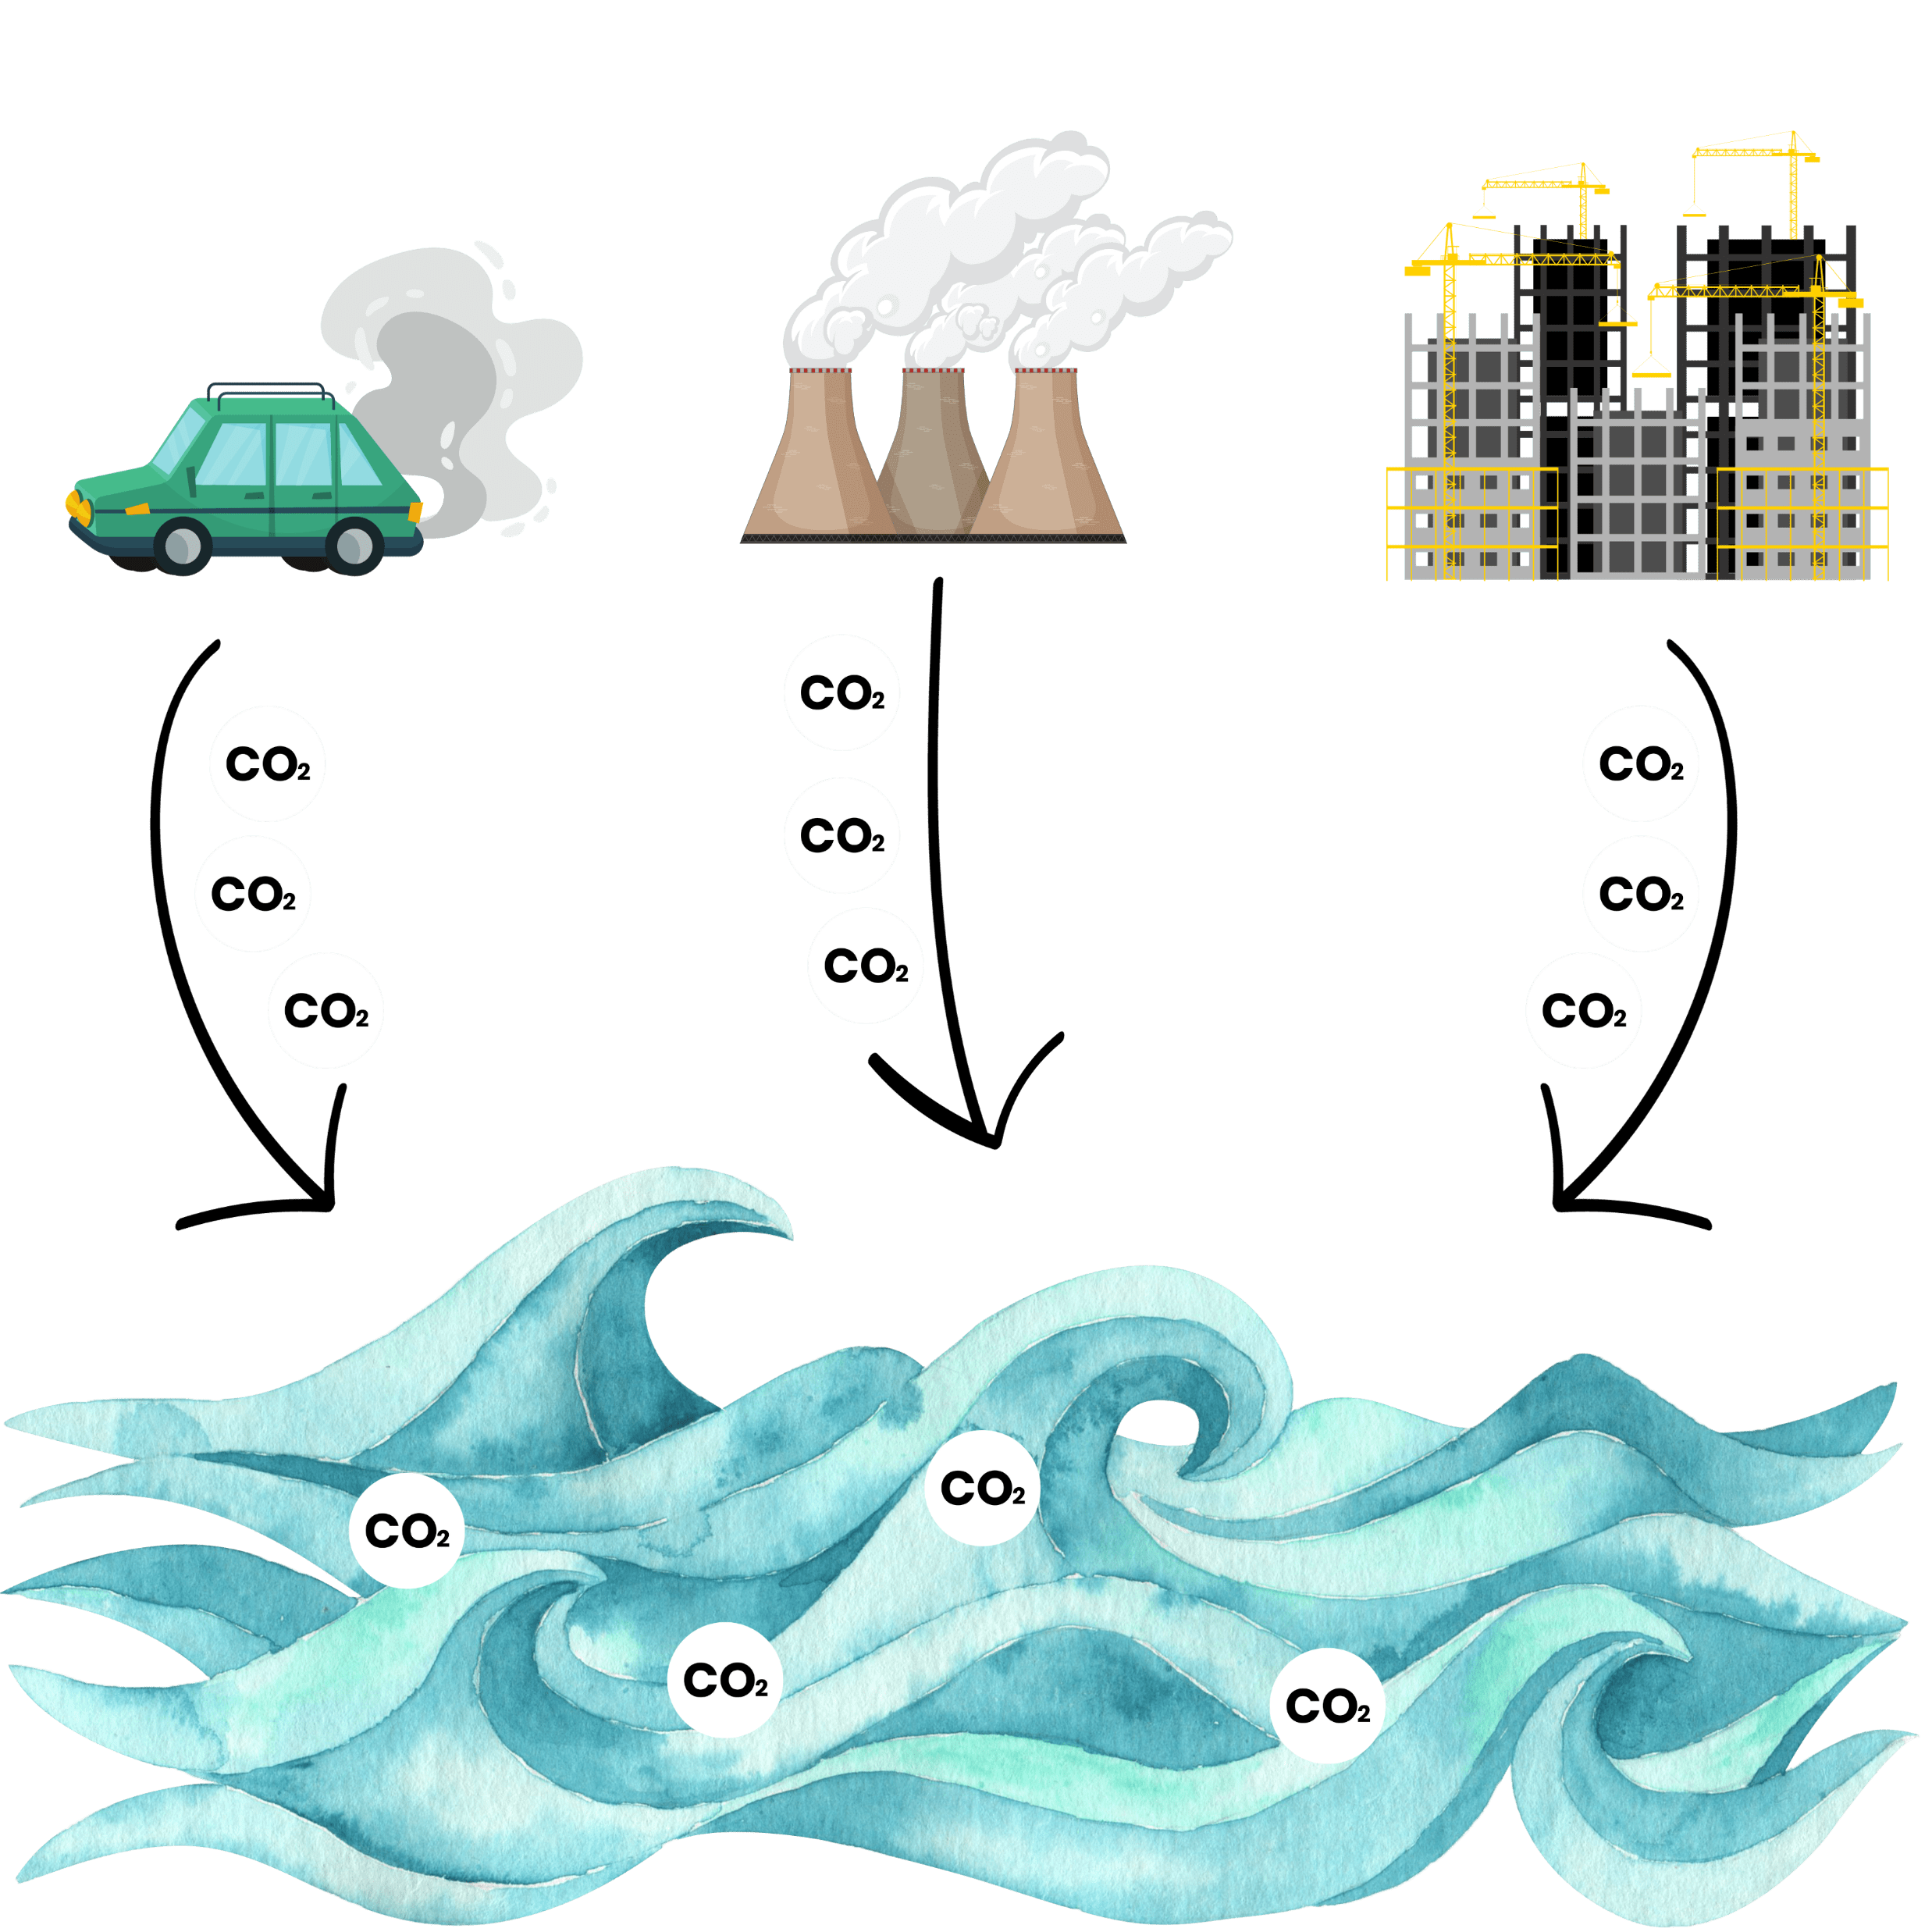
AU2.3
Such as drive gas cars, running factories and energy plants, and building more buildings for us humans etc.

Slide 25
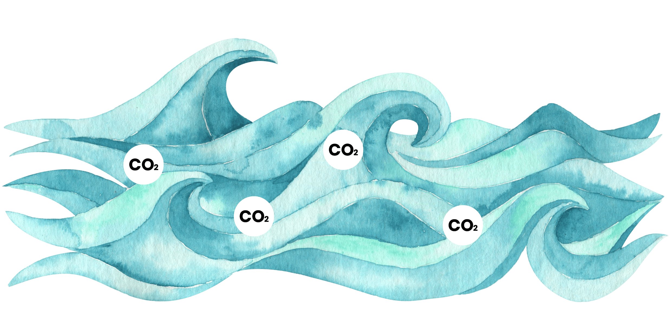
AU2.3
CO²
As levels of CO² in the atmosphere continue to increase, the ocean continues to absorb more and more CO², like a sponge!
CO²
CO²
CO²
CO²
CO²

Slide 26
AU2.3
CO²
CO²
CO²
CO²
CO²
CO²
Notes:
CO2 being absorbed

Slide 27
AU2.3
It has sucked up so much CO² that it has changed chemistry of the ocean and has made it more acidic like vinegar!
This is the consequence of increasing greenhouse gases in the atmosphere which is driving climate change.
Notes:
This concept can be a little tricky – ocean acidification is a consequence of the cause of climate change, that being increased CO2 in atmosphere. It is still linked to climate change but not directly linked the literal climate changing.

Slide 28
AU2.3
So, what happens to the ocean and the creatures that call it home when it becomes more acidic?
Notes:
Explain the experiment they are about to undergo.

Slide 29
AU2.3
Ocean Acidification
Put a shell or piece of dead coral in a glass
Fill the cup with vinegar until it just covers the shell/coral
Predict what you think will happen to the shell/coral in the cup and observe.
Notes:
Demonstrate the effects of CO2 on water by placing a seashell or piece of dead coral in a cup of vinegar.
Students write on their handouts predictions about what will happen.
Over time, the vinegar (acidic) will start to dissolve the seashell, simulating the effects of ocean acidification on marine life.

Slide 30
AU2.3
Results & Discussion

Slide 31
AU2.3
Ocean acidification :
What happened to the piece of shell/ coral when submerged in vinegar?
Notes:
Over time, the vinegar (acidic) will start to dissolve the seashell, simulating the effects of ocean acidification on marine life.
Take the time to fill out the “What happened” Section of their handout before moving on to the optional graphs and extension task. (see extension task worksheet)

Slide 32
AU2.3
Ocean acidification :
The piece of shell/coral began to dissolve in the acidic vinegar because it is made of calcium carbonate – a compound that dissolves in acidic environments!
What do you think an acidic ocean might do to our reefs and marine life here in the Cayman Islands?
Notes:
Other ocean creatures such as crabs, lobsters, marine snails etc. have calcium carbonate in their shells which means they are vulnerable to this change in pH.
Encourage students to reflect on how these changes might impact the Cayman Islands and its marine life.
Have students complete the third column of their handouts, considering the potential effects of climate change on the local environment

Slide 33
AU2.3
Temperature change:
What happened to the temperatures of the two cups and why?
Notes:
Gather the class and return to the cups of water and measure the new temperatures of each cup
Discuss the difference of the two temperatures.
Students to complete handout - “What Happened”

Slide 34
AU2.3
Temperature change:
The cup in the sun was much warmer than the cup in the cupboard.
If our atmosphere is warming because of climate change, what do you think this may do to the oceans?

Slide 35
AU2.3
Temperature change:
How do you think a warmer ocean might affect our life here in the Cayman Islands?
Notes:
Encourage students to reflect on how these changes in ocean temperatures and sea level rise might impact the Cayman Islands and its marine life.
Have students complete the third column of their handouts, considering the potential effects of climate change on the local environment

Slide 36
AU2.3
Sea Level rise :
What happened to the water level in the container and to the animals living above water?
Notes:
Discuss the amount of change and what happened.
Ask - What does the item in the water represent?
Students to complete “What Happened” section.

Slide 37
AU2.3
Sea Level rise :
The ice melted and the level of water in the container got higher and flooded the surface the animals were sitting on!
If ice continues to melt in the polar regions of the world and climate change continues, what might happen to other animals, including us, living on land?

Slide 38
AU2.3
Sea Level rise :
How do you think sea level rise might affect a small islands nation like ours here in the Caribbean?
Notes:
Encourage students to reflect on how these changes in ocean temperatures and sea level rise might impact the Cayman Islands and its marine life.
Have students complete the third column of their handouts, considering the potential effects of climate change on the local environment

Slide 39
AU1.1

