Slide 1
Atmosphere Mini Unit
AU3.1: How is climate change affecting the climate and weather in the Cayman Islands?
Objective: Students will learn about how climate change is affecting the Cayman Islands. Students will consider how climate and weather may be affecting them due to climate change. | Criteria: They should understand the difference between climate and weather and how the greenhouse effects if contributing to climate change and impacting our environment globally. This lesson will go into more detail about how it is affecting us here specifically.
Process: Students will move around 4 different stations watching the station videos and other resources at the stations to fill out the activity handout. They should interact with each station beofre they leave, leaving behind a sticky note with a question, statement or concern at each station. The lesson will conclude by looking over they found between each station, comparing and sharing with the class. End the lesson by asking them how climate change could impact their everyday lives through one of these aspects.
Resources: Lesson Plan Presentation 4 Station videos Activity hand out and station resources | Notes: Teachers should print out overview of slide show, including the notes for each slide. This will help the lesson flow. The lesson plan can be used in conjunction with the slide show, or the slide show could be used as the plan itself.

Slide 2
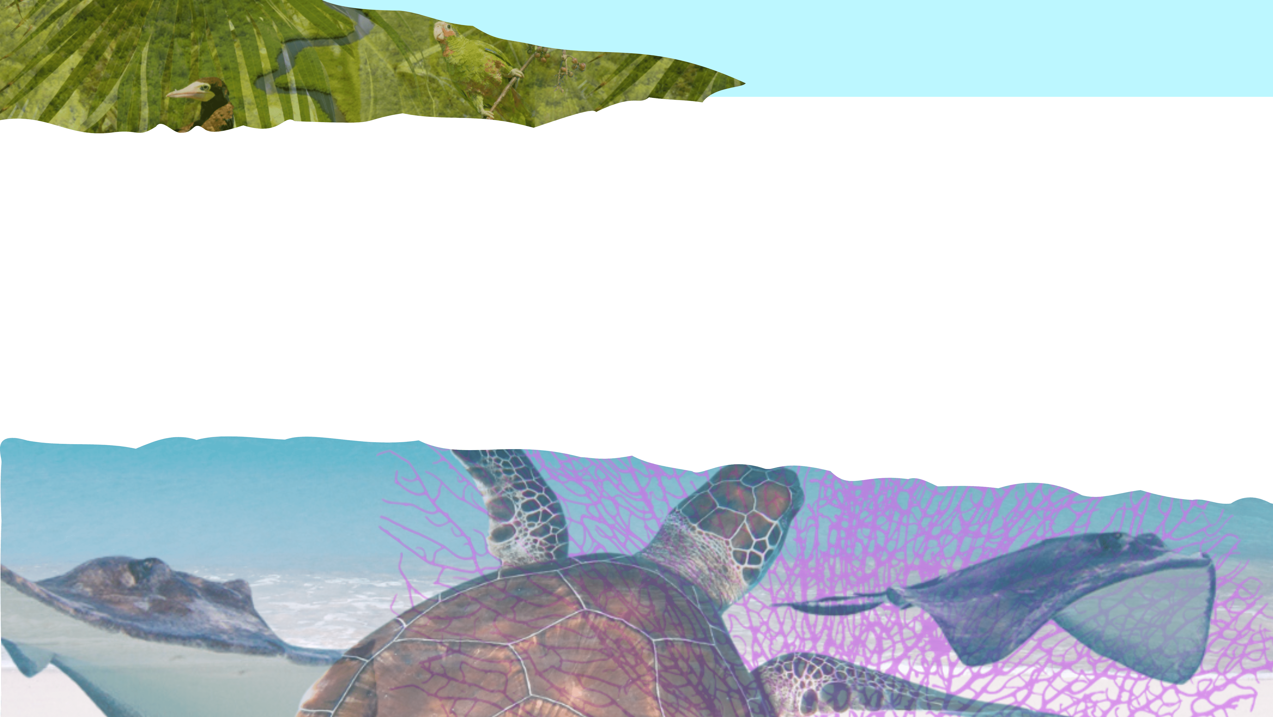
How is Climate Change affecting climate and weather in Cayman?
Atmosphere Mini Unit: Topic 3, Lesson 3.1

Slide 3
AU3.1
Station Activity
Introduction
Conclusion

Slide 4
AU3.1
Introduction
Notes:
Introduce the topic briefly and link to previous knowledge from T1 and T2.

Slide 5
AU3.1
What is the difference between climate and weather?
Notes:
Ask the students to put their hands up if they can give the correct definitions

Slide 6
AU3.1
Weather is:
The day-to-day variation of the atmospheres condition locally.

Slide 7
AU3.1
Climate is:
The variation of weather conditions over longer periods of time, usually years.

Slide 8
AU3.1
Ice age
Heave wave
Hurricane
Seasons
Climate | Weather
Tornado
Annual Rainfall
Hurricane Season
Sea breeze
Drought
Lightning
Notes:
Match game – start with Seasons and move through the icons clockwise. The icon will move into the correct category as you go through the slides.

Slide 9
AU3.1
Ice age
Heave wave
Hurricane
Climate | Weather
Seasons
Tornado
Annual Rainfall
Hurricane Season
Sea breeze
Drought
Lightning

Slide 10
AU3.1
Ice age
Heave wave
Climate | Weather
Seasons
Hurricane
Tornado
Annual Rainfall
Hurricane Season
Sea breeze
Drought
Lightning
Notes:
Ask student if anyone knows what the ice age is, they may have seen the ice age movies! Explain that the ice age was a period in the earths history where the world was covered in ice and very cold, and that the earth goes through cycles and one day we will have the ice age again!

Slide 11
AU3.1
Heave wave
Climate | Weather
Seasons
Ice age
Hurricane
Tornado
Annual Rainfall
Hurricane Season
Sea breeze
Drought
Lightning

Slide 12
AU3.1
Climate | Weather
Seasons
Ice age
Hurricane
Heave wave
Tornado
Annual Rainfall
Hurricane Season
Sea breeze
Drought
Lightning

Slide 13
AU3.1
Climate | Weather
Seasons
Ice age
Hurricane
Heave wave
Tornado
Annual Rainfall
Hurricane Season
Sea breeze
Drought
Lightning

Slide 14
AU3.1
Climate | Weather
Seasons
Ice age
Drought
Hurricane
Heave wave
Tornado
Annual Rainfall
Hurricane Season
Sea breeze
Lightning

Slide 15
AU3.1
Climate | Weather
Seasons
Ice age
Drought
Hurricane
Heave wave
Lightning
Tornado
Annual Rainfall
Hurricane Season
Sea breeze

Slide 16
AU3.1
Climate | Weather
Seasons
Ice age
Drought
Hurricane
Heave wave
Lightning
Tornado
Annual Rainfall
Sea breeze
Hurricane Season

Slide 17
AU3.1
Climate | Weather
Seasons
Ice age
Drought
Hurricane
Heave wave
Lightning
Tornado
Annual Rainfall
Sea breeze
Hurricane Season

Slide 18
AU3.1
Climate | Weather
Drought
Hurricane
Lightning
Seasons
Ice age
Heave wave
Tornado
Annual Rainfall
Hurricane Season
Sea breeze

Slide 19
AU3.1
What is the Greenhouse Effect?
Notes:
Ask students if they remember what the Greenhouse Effect is and if anyone can explain it.

Slide 20
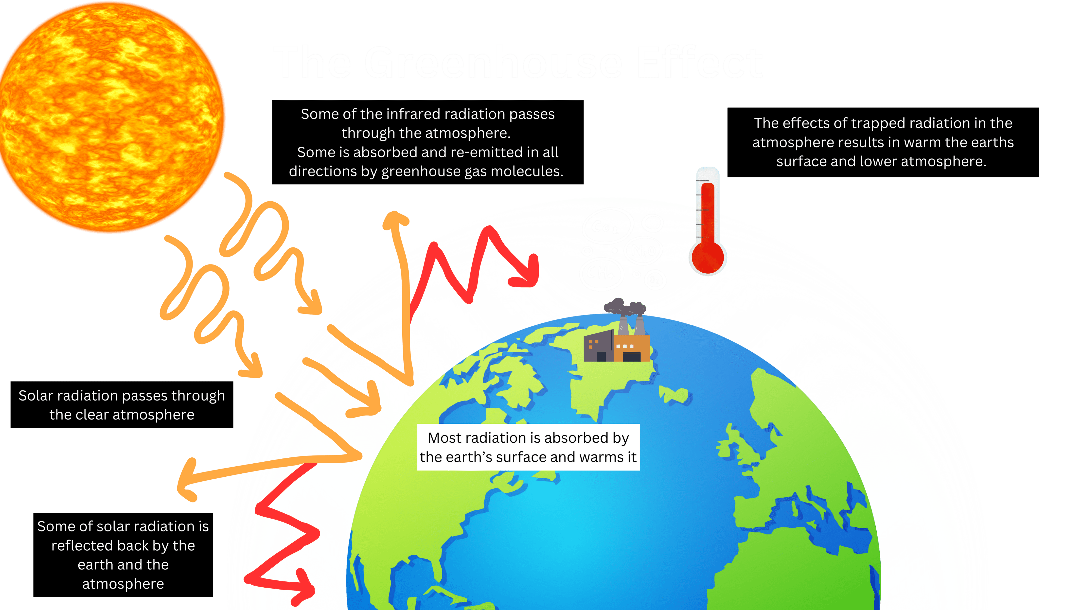
AU3.1
Notes:
Give them a brief review of the greenhouse effect and how it effects the atmosphere

Slide 21
AU3.1
How is this impacting climate change?
Notes:
How is the greenhouse effect linked to climate change:
- rising temperatures
sea level rise
ocean acidification
These are all impacts to the oceans that we previously learned about, now we will look at the impacts on weather in the Cayman Islands

Slide 22
AU3.1
Station Activity

Slide 23
AU3.1
How is climate change impacting Cayman?
Notes:
Can any of the students think of a way climate change could impact Cayman before they start the activity?

Slide 24
AU3.1
Station activity
Break up into smaller groups
Move around the different stations
Watch the station videos and use the other materials at your station to record the effect of climate change on your station’s topic
5-7 mins
Notes:
Break students up into smaller groups, assign them to a station and provide them with a worksheet to carry with them from station to station throughout the lesson.
Using the guided notes and resources at each station, prompt the students to observe and record the effects of climate change on their station’s topic e.g. extreme weather. They can record their findings through writing or drawing. See leveled worksheet options.
Optional: Model the first station with the whole class first and then send them off.
Rotate the groups to the next station after a set amount of time (e.g., 5-7 mins) and repeat until they have interacted with each station.
Interact with the station before they leave, leave a question or statement or concern at each station.
Check in between stations, mini plenary, checking for understanding

Slide 25
AU3.1
Leave a question, statement or concern at each station
Notes:
They should interact with the station before they leave, leaving a question or statement or concern at each station. Leave it as a post-it notes on each station or write on the fact sheet for the next group to see.

Slide 26
AU3.1
Conclusion

Slide 27
AU3.1
What were 3 difference you found between each station?
What were 3 statements and 3 questions you have?
Think, Pair, Share!
Notes:
Conclude the lesson by asking students to review the differences they found between each station and share some. Think pair share, come up with 3 things, 3 statements and 3 questions.
Est 5-10 mins

Slide 28
AU3.1
How do you think climate change might impact your life here in Cayman?
Notes:
Ask them to think about how climate change could impact their everyday lives through one of the aspects.
Ask for several answers as the students leave the room or move onto their next subject for the day.

