Slide 1
Atmosphere Mini Unit
SP1: What can WE do!?
Objective: To understand the different ‘levels’ of intervention, from the individual, family, community and society. To be able to make suggestions about action to reduce climate change or mitigate against its effects. To make judgements on efficacy of different actions and rank their impact and importance. | Criteria: This lesson is an opportunity for the children to think about the actions that could be taken at different levels within society, from governments to individuals. This is an important part of making the children understand that actions can make a difference.
Process: What about something that addresses the different levels of impact: - Individual (What could I do?) - Family (What could my family do? ) - Community (What could my neighbourhood and/or school do? Or what could I ask my school to do?) - Society (What could the Cayman Islands do? Or what could I ask the government to do?). This addresses the key issue of bottom up and top down as well as acknowledging the different scale of the impact that can be made by different players or different sizes and influence.
Resources: Blank Diamond 9 Example Diamond 9 Presentation and lesson plan | Notes: Ensure that notes and presentation are printed and read before lesson.

Slide 2
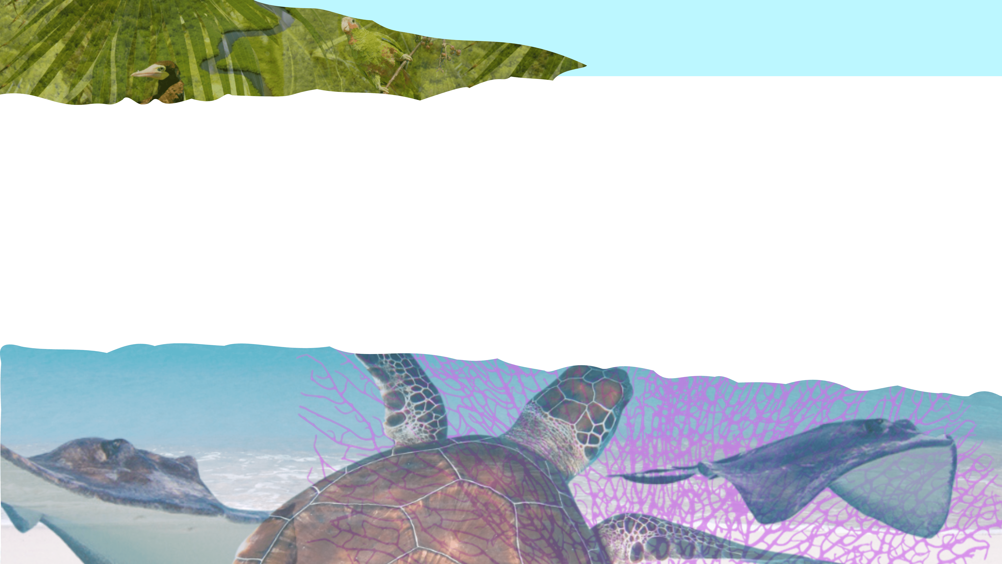
What can WE do?!
Atmosphere Mini Unit: Summative Lesson 1

Slide 3
SP1
What could WE do?
Introduction
Your Diamond 9!
Conclusion

Slide 4
SP1
Introduction

Slide 5
SP1
In this lesson we will look at some of the ways that we can take action to make a positive difference about climate change.
Before we continue, does anyone have any ideas about things that we could do?

Slide 6
SP1
What does ‘we’ mean?
Can you think of different groups that might be called ‘us’ or ‘we’?

Slide 7
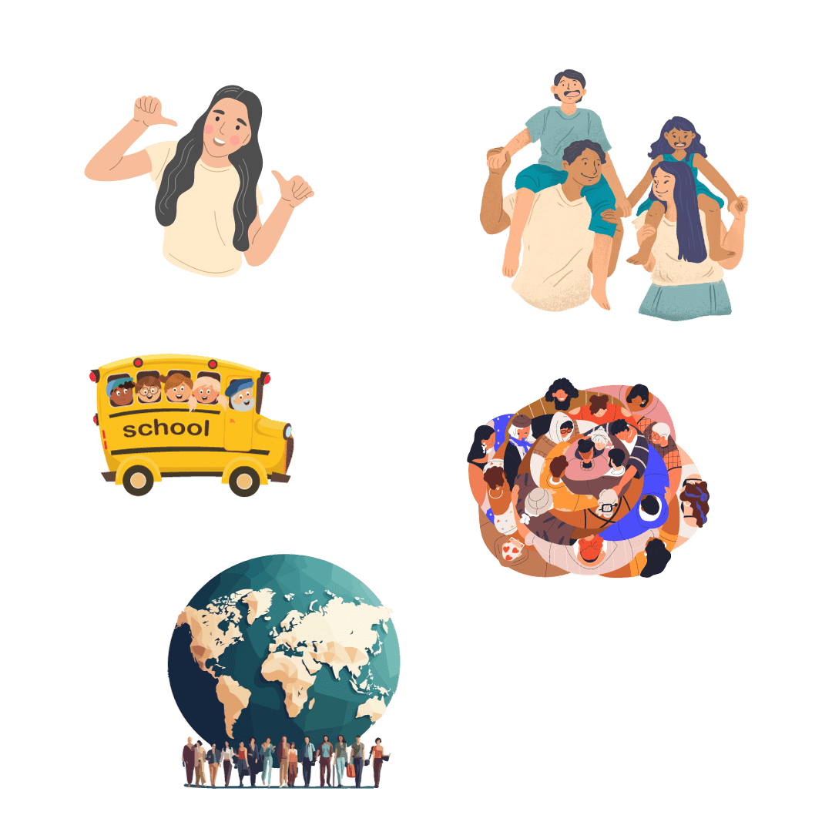
SP1
Different versions of us!
An individual
A family
A school
A community
A society
Notes:
Once the teacher has gone through the list, they can reveal the question. The question is purposefully a bit confusing and vague.
It is likely that the children will think that they will have the most influence the further towards the top of the list they look. They can change their actions as an individual; they can influence their family, they might have some influence in their school. But as they get towards the bottom of the list they will feel like they have very little power.
The second part of the question is about impact, and they might rightly say that the most impact will be felt at the largest scale, so that although they have very little influence on society, the greatest positive impact on climate change might happen at a society level. This is a point worth exploring and drawing out from a short class discussion with the children. The teacher might want to choose something relatively simple like recycling, to demonstrate that a society wide approach would have a much bigger impact than some individuals and families chose to do more recycling…

Slide 8
SP1
Different versions of us!
An individual
A family
A school
A community
A society
In which of these do you think your voice might be loudest and you might be able to make the most impact?
Notes:
Once the teacher has gone through the list, they can reveal the question. The question is purposefully a bit confusing and vague.
It is likely that the children will think that they will have the most influence the further towards the top of the list they look. They can change their actions as an individual; they can influence their family, they might have some influence in their school. But as they get towards the bottom of the list they will feel like they have very little power.
The second part of the question is about impact, and they might rightly say that the most impact will be felt at the largest scale, so that although they have very little influence on society, the greatest positive impact on climate change might happen at a society level. This is a point worth exploring and drawing out from a short class discussion with the children. The teacher might want to choose something relatively simple like recycling, to demonstrate that a society wide approach would have a much bigger impact than some individuals and families chose to do more recycling…

Slide 9
SP1
You will be looking at some of these ‘versions of us’
Notes:
This addresses the key issue of bottom up and top down as well as acknowledging the different scale of the impact that can be made by different players or different sizes and influence.

Slide 10
SP1
You will be looking at some of these ‘versions of us’
Before we do that, we are going to learn a little bit about what approaches could be taken at a large scale by looking at what our society could do to reduce things that cause climate change and what actions it could take to respond effectively to its negative impacts.
Notes:
This addresses the key issue of bottom up and top down as well as acknowledging the different scale of the impact that can be made by different players or different sizes and influence.

Slide 11
SP1
What could
WE do?
Notes:
This addresses the key issue of bottom up and top down as well as acknowledging the different scale of the impact that can be made by different players or different sizes and influence.

Slide 12
SP1
What could we do as a society?
Notes:
This addresses the key issue of bottom up and top down as well as acknowledging the different scale of the impact that can be made by different players or different sizes and influence.

Slide 13
SP1
What could we do as a society?
We will now look at some of the things that we could do as a society that would make a positive difference.
Notes:
This part of the lesson is very much a teaching part, where the teacher will outline some strategies and technologies that address climate change.

Slide 14
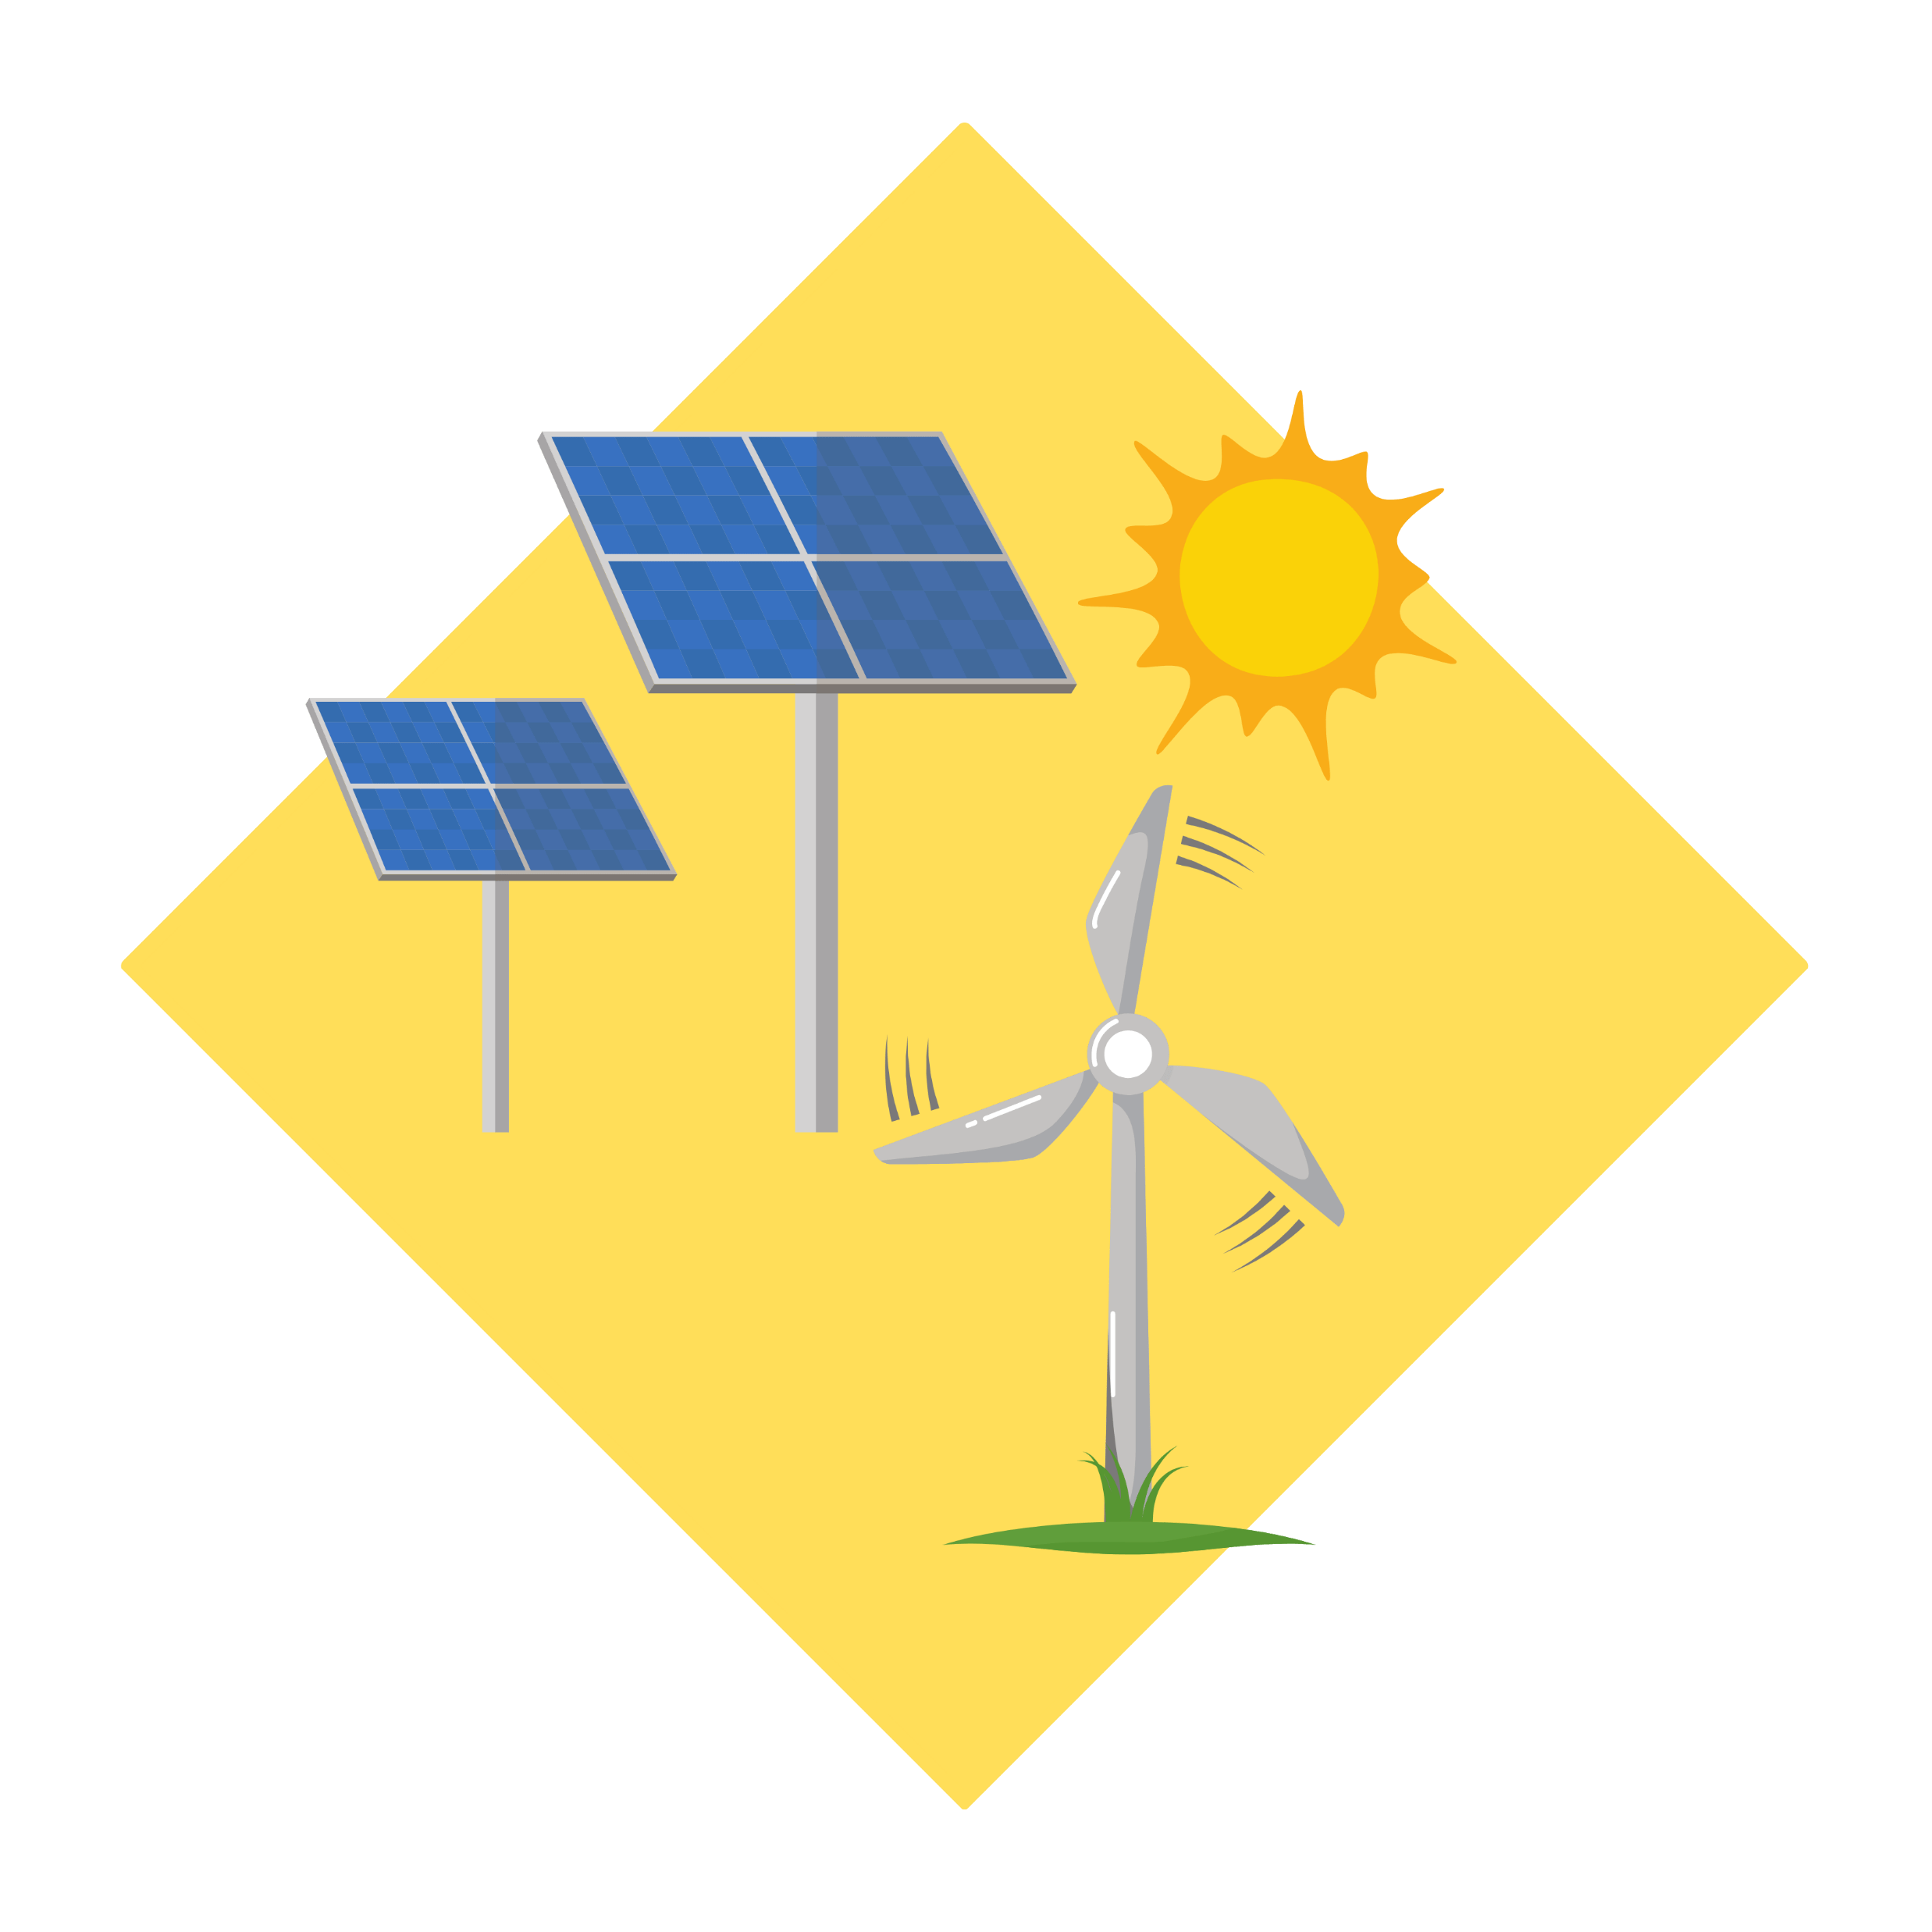
SP1
Using Sun and Wind Power:
The government can encourage people to use electrical energy produced by the sun and wind, which are cleaner and better for our planet.
Notes:
Need to outline and illuminate all or some of the following:
Renewable Energy Promotion:
Implement policies and incentives to encourage the adoption of renewable energy sources like solar, wind, and geothermal power.
Set targets for renewable energy capacity and strive to achieve energy independence.
Benefits include:
Fighting Climate Change: Renewable energy production helps reduce greenhouse gas emissions, slowing down global warming and climate change.
Clean Air: Using renewable energy sources like the sun and wind means less pollution, making the air we breathe fresher and healthier.
Protecting Nature: Renewable energy projects cause less harm to wildlife and natural habitats compared to fossil fuel extraction.
Conserving Resources: Renewable energy is infinite, so we don't have to worry about running out of it like we do with fossil fuels.
Cleaner Water: Unlike some energy sources, renewable energy production doesn't pollute water, helping to keep our waterways clean.

Slide 15
SP1
Saving Energy:
We can try to use electricity and other things more carefully and only build buildings that are efficient, so we don’t waste energy.
Notes:
Need to outline and illuminate all or some of the following:
Energy Efficiency Programs:
Establish energy efficiency standards for buildings and appliances.
Offer financial incentives for energy-efficient upgrades and technologies.
Benefits include:
Less Pollution: Energy efficiency programs help cut down on energy waste, which means fewer harmful gases are released into the air, making the environment cleaner.
Fighting Climate Change: By using energy smarter, we can reduce greenhouse gases that cause global warming and help protect the planet.
Saving Resources: Energy efficiency means using less non-renewable resources like coal and oil, which helps preserve them for the future.
Protecting Nature: Using energy efficiently reduces damage to the environment and wildlife habitats, helping plants and animals thrive.
Cleaner Air and Water: Energy efficiency lowers the need for polluting power sources, improving the quality of the air we breathe and the water we drink.
Eco-Friendly Future: Embracing energy efficiency is like being a superhero for the Earth, ensuring a sustainable and green future for everyone.

Slide 16
SP1
Better ways to travel:
The government can help make buses better so more people use them and we don’t have to drive cars as much.
Notes:
Need to outline and illuminate all or some of the following:
Sustainable Transportation:
Develop and expand public transportation options to reduce reliance on private vehicles.
Develop electric or hydrogen vehicles and phase out combustion engines.
Invest in infrastructure for electric vehicle charging stations.
Encourage the use of bicycles and walking for short distances.
Benefits include:
Cleaner Air: Sustainable transportation, like electric cars and bikes, produces fewer harmful emissions, making the air we breathe cleaner and healthier.
Fighting Climate Change: By using eco-friendly transportation, we reduce greenhouse gases that heat up the Earth and help protect the climate.
Saving Energy: Sustainable transportation uses less fuel or renewable energy, which helps conserve valuable resources for the future.
Protecting Nature: Using eco-friendly vehicles reduces pollution and protects wildlife and natural habitats.

Slide 17
SP1
Taking care of nature:
We need to plant more trees and protect animals and plants so that the Earth stays healthy.
Notes:
Need to outline and illuminate all or some of the following:
Reforestation and Conservation:
Implement reforestation projects to restore and expand natural carbon sinks.
Preserve and protect existing ecosystems and biodiversity to enhance resilience.
Benefits include:
Protecting Wildlife: Conservation and reforestation create safe habitats for animals and plants, helping protect their homes and prevent extinction.
Cleaner Air: Trees absorb carbon dioxide, a harmful gas that causes climate change, and release oxygen, making the air fresher and healthier.
Preventing Soil Erosion: Trees and plants help keep the soil in place, preventing erosion and protecting our land.
Biodiversity: Conservation and reforestation promote a variety of plant and animal species, making our ecosystems more diverse and balanced.
Fighting Climate Change: More trees mean less carbon in the atmosphere, which helps fight global warming and keeps the Earth cooler.
Sustainable Resources: Reforestation ensures a steady supply of wood and other forest products without harming the environment.

Slide 18
SP1
Less consumption and more recycling:
We should try to use less stuff and recycle what we can, so we don’t make too much trash. This could be encouraged through a container deposit money back program.
Notes:
Need to outline and illuminate all or some of the following:
Waste management, reducing consumption and recycling:
Enhance waste management practices, including waste reduction, recycling, and composting.
Encourage less consumption when not needed.
Implement waste-to-energy initiatives to reduce greenhouse gas emissions from landfill sites.
Benefits include:
Cleaner Environment: Proper waste management and recycling keep our surroundings clean, preventing pollution and protecting wildlife.
Less Pollution: Reducing consumption and recycling mean less garbage is burned or buried, reducing harmful emissions and conserving energy.
Saving Resources: Recycling helps turn old things into new ones, saving resources like paper, metal, and plastic for future use.
Fighting Climate Change: Waste management and recycling reduce greenhouse gas emissions, helping combat global warming and its effects.
Biodiversity Protection: Proper waste disposal and recycling prevent harm to nature, preserving habitats for plants and animals.

Slide 19
SP1
Protecting our beaches:
The government can build special things to protect out beaches from getting damaged and stop people building on them.
Notes:
Need to outline and illuminate all or some of the following:
Coastal Protection and Erosion Control:
Invest in coastal protection measures to safeguard against rising sea levels and extreme weather events.
Implement erosion control strategies to protect critical infrastructure and habitats.
Benefits include
Protecting Shoreline: Coastal protection and erosion control measures safeguard beaches and land from being washed away by waves and storms.
Preserving Wildlife: Healthy coastal areas provide habitats for various marine animals and birds, preserving biodiversity.
Preventing Coastal Flooding: These measures help reduce the risk of flooding in coastal communities during storms and high tides.
Maintaining Natural Beauty: Coastal protection ensures that our beaches and scenic areas remain beautiful and enjoyable for everyone.
Mitigating Climate Change: Coastal ecosystems, like mangroves and salt marshes, capture carbon and help fight climate change.
Sustainable Tourism: By preserving our coasts, we support sustainable tourism and local economies that depend on beach attractions.
Resilience to Climate Events: Coastal protection and erosion control enhance our resilience to the impacts of climate change, such as rising sea levels and extreme weather.

Slide 20
SP1
Learning about climate:
All schools should teach about climate change and how it affects us, so we all know what we can do to help.
Notes:
Need to outline and illuminate all or some of the following:
Climate Education and Awareness:
Conduct public awareness campaigns to educate citizens about climate change and its impacts.
Introduce climate change education in schools and integrate sustainable practices into the curriculum.
Benefits include:
Understanding Climate Change: Climate education helps us learn about global warming and its effects on the environment.
Making Informed Choices: Being aware of climate issues empowers us to make eco-friendly decisions in our daily lives.
Taking Action: Climate education inspires us to take action and be part of solutions to protect the planet.
Advocating for Change: Being informed allows us to speak up and support policies that promote sustainability and conservation.
Protecting Wildlife: Climate education helps us understand how climate change affects animals and plants, motivating us to protect biodiversity.
Sustainable Living: Learning about climate change encourages us to adopt sustainable practices, like reducing waste and using renewable energy.
Resilience to Climate Events: Understanding climate impacts prepares us to face and adapt to extreme weather and other climate-related challenges.

Slide 21
SP1
Being ready for changes:
The government must plan and prepare for big changes in the climate and make sure land use and buildings are suitable for a changing world.
Notes:
Need to outline and illuminate all or some of the following:
Climate Resilience Planning:
Conduct vulnerability assessments to identify climate-related risks and develop climate adaptation and resilience plans.
Incorporate climate resilience measures into infrastructure projects and land-use planning.
Benefits include:
Weathering Climate Challenges: Climate resilience planning helps communities prepare for and cope with extreme weather events like storms and floods.
Protecting Homes and Nature: By planning ahead, we can build homes and infrastructure that can withstand climate impacts, reducing damage to the environment.
Saving Lives: Climate resilience measures can save lives by providing early warnings and safe evacuation plans during disasters.
Preserving Resources: Resilience planning ensures we use resources wisely, conserving water, energy, and other essentials.
Helping Wildlife: Planning for climate resilience protects habitats and wildlife, ensuring they have a safe place to thrive.
Sustainable Development: Resilience planning promotes smart and eco-friendly development that benefits both people and the environment.
Being Ready for Change: By preparing for climate changes, we can adapt to new conditions and keep our planet healthy for the future.

Slide 22
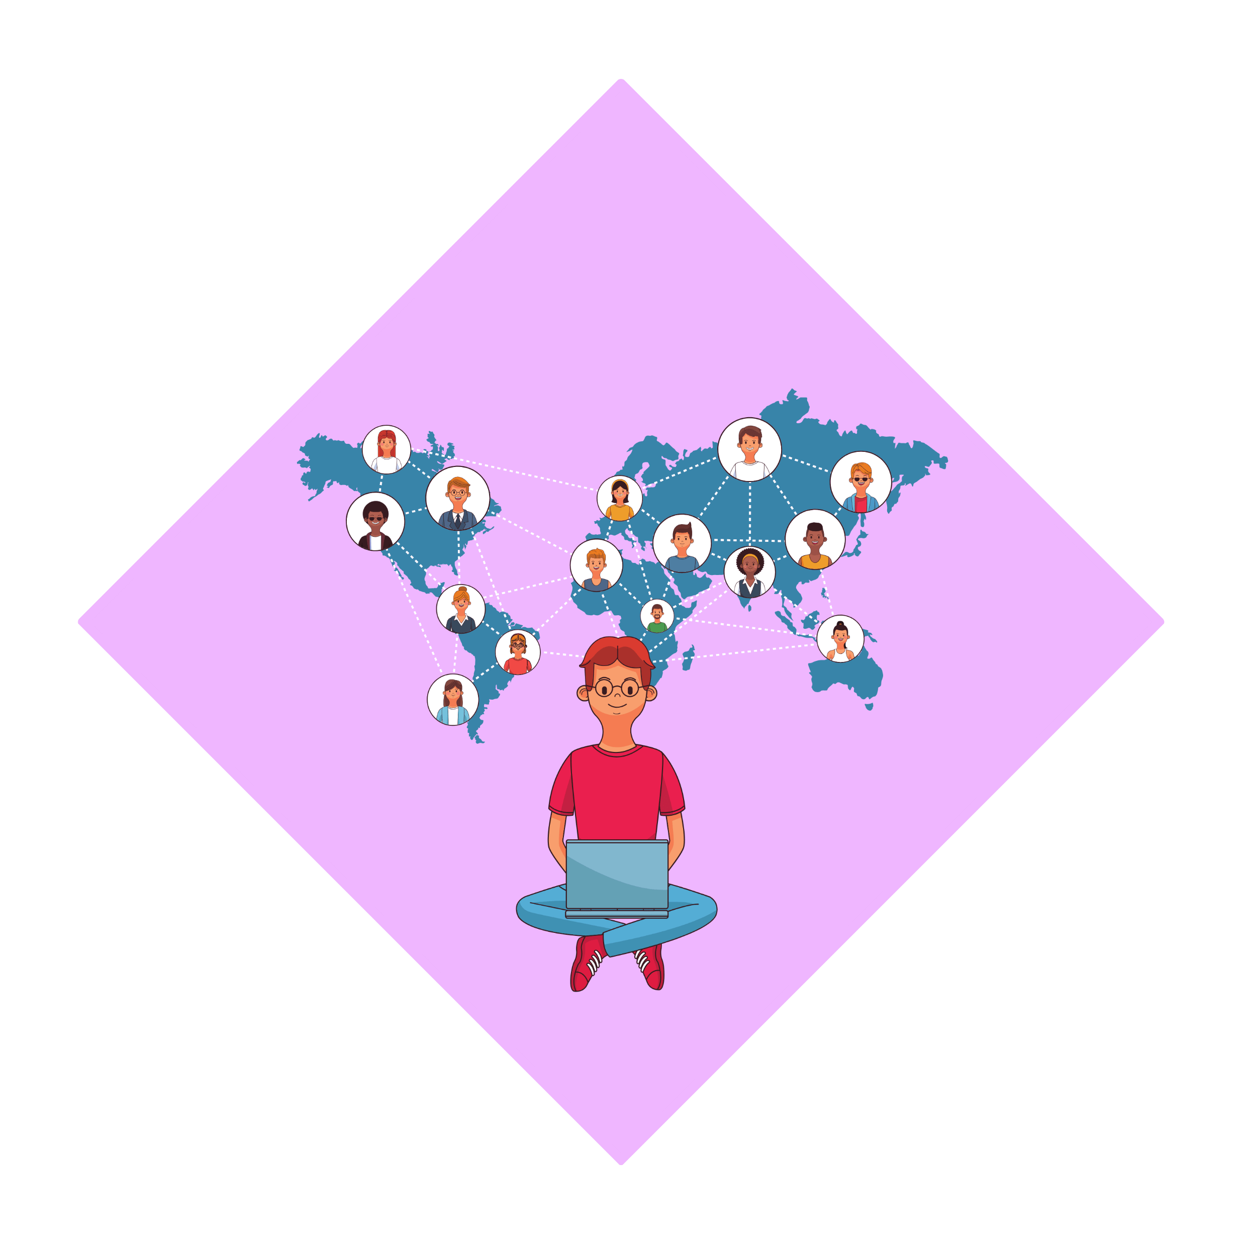
SP1
Working together with other countries:
We can talk, work and make agreements with other countries to help each other and the whole world stay safe from climate change.
Notes:
Need to outline and illuminate all or some of the following:
International Collaboration:
Engage in international climate agreements and partnerships to address global climate challenges.
Advocate for climate action at international forums and collaborate with other nations on best practices.
Benefits include:
Sharing Knowledge: International collaboration allows countries to share ideas and knowledge about protecting the environment.
Solving Global Problems: Working together helps tackle big issues like climate change that affect the whole world.
Protecting Wildlife: Collaborating with other countries helps save endangered species and preserve natural habitats.
Sharing Resources: Countries can pool resources and technologies to find better ways to protect the planet.
Learning from Each Other: By collaborating, we can learn from different cultures and approaches to environmental conservation.
Stronger Together: When countries join forces, they can have a bigger impact and make a real difference in saving the Earth.

Slide 23
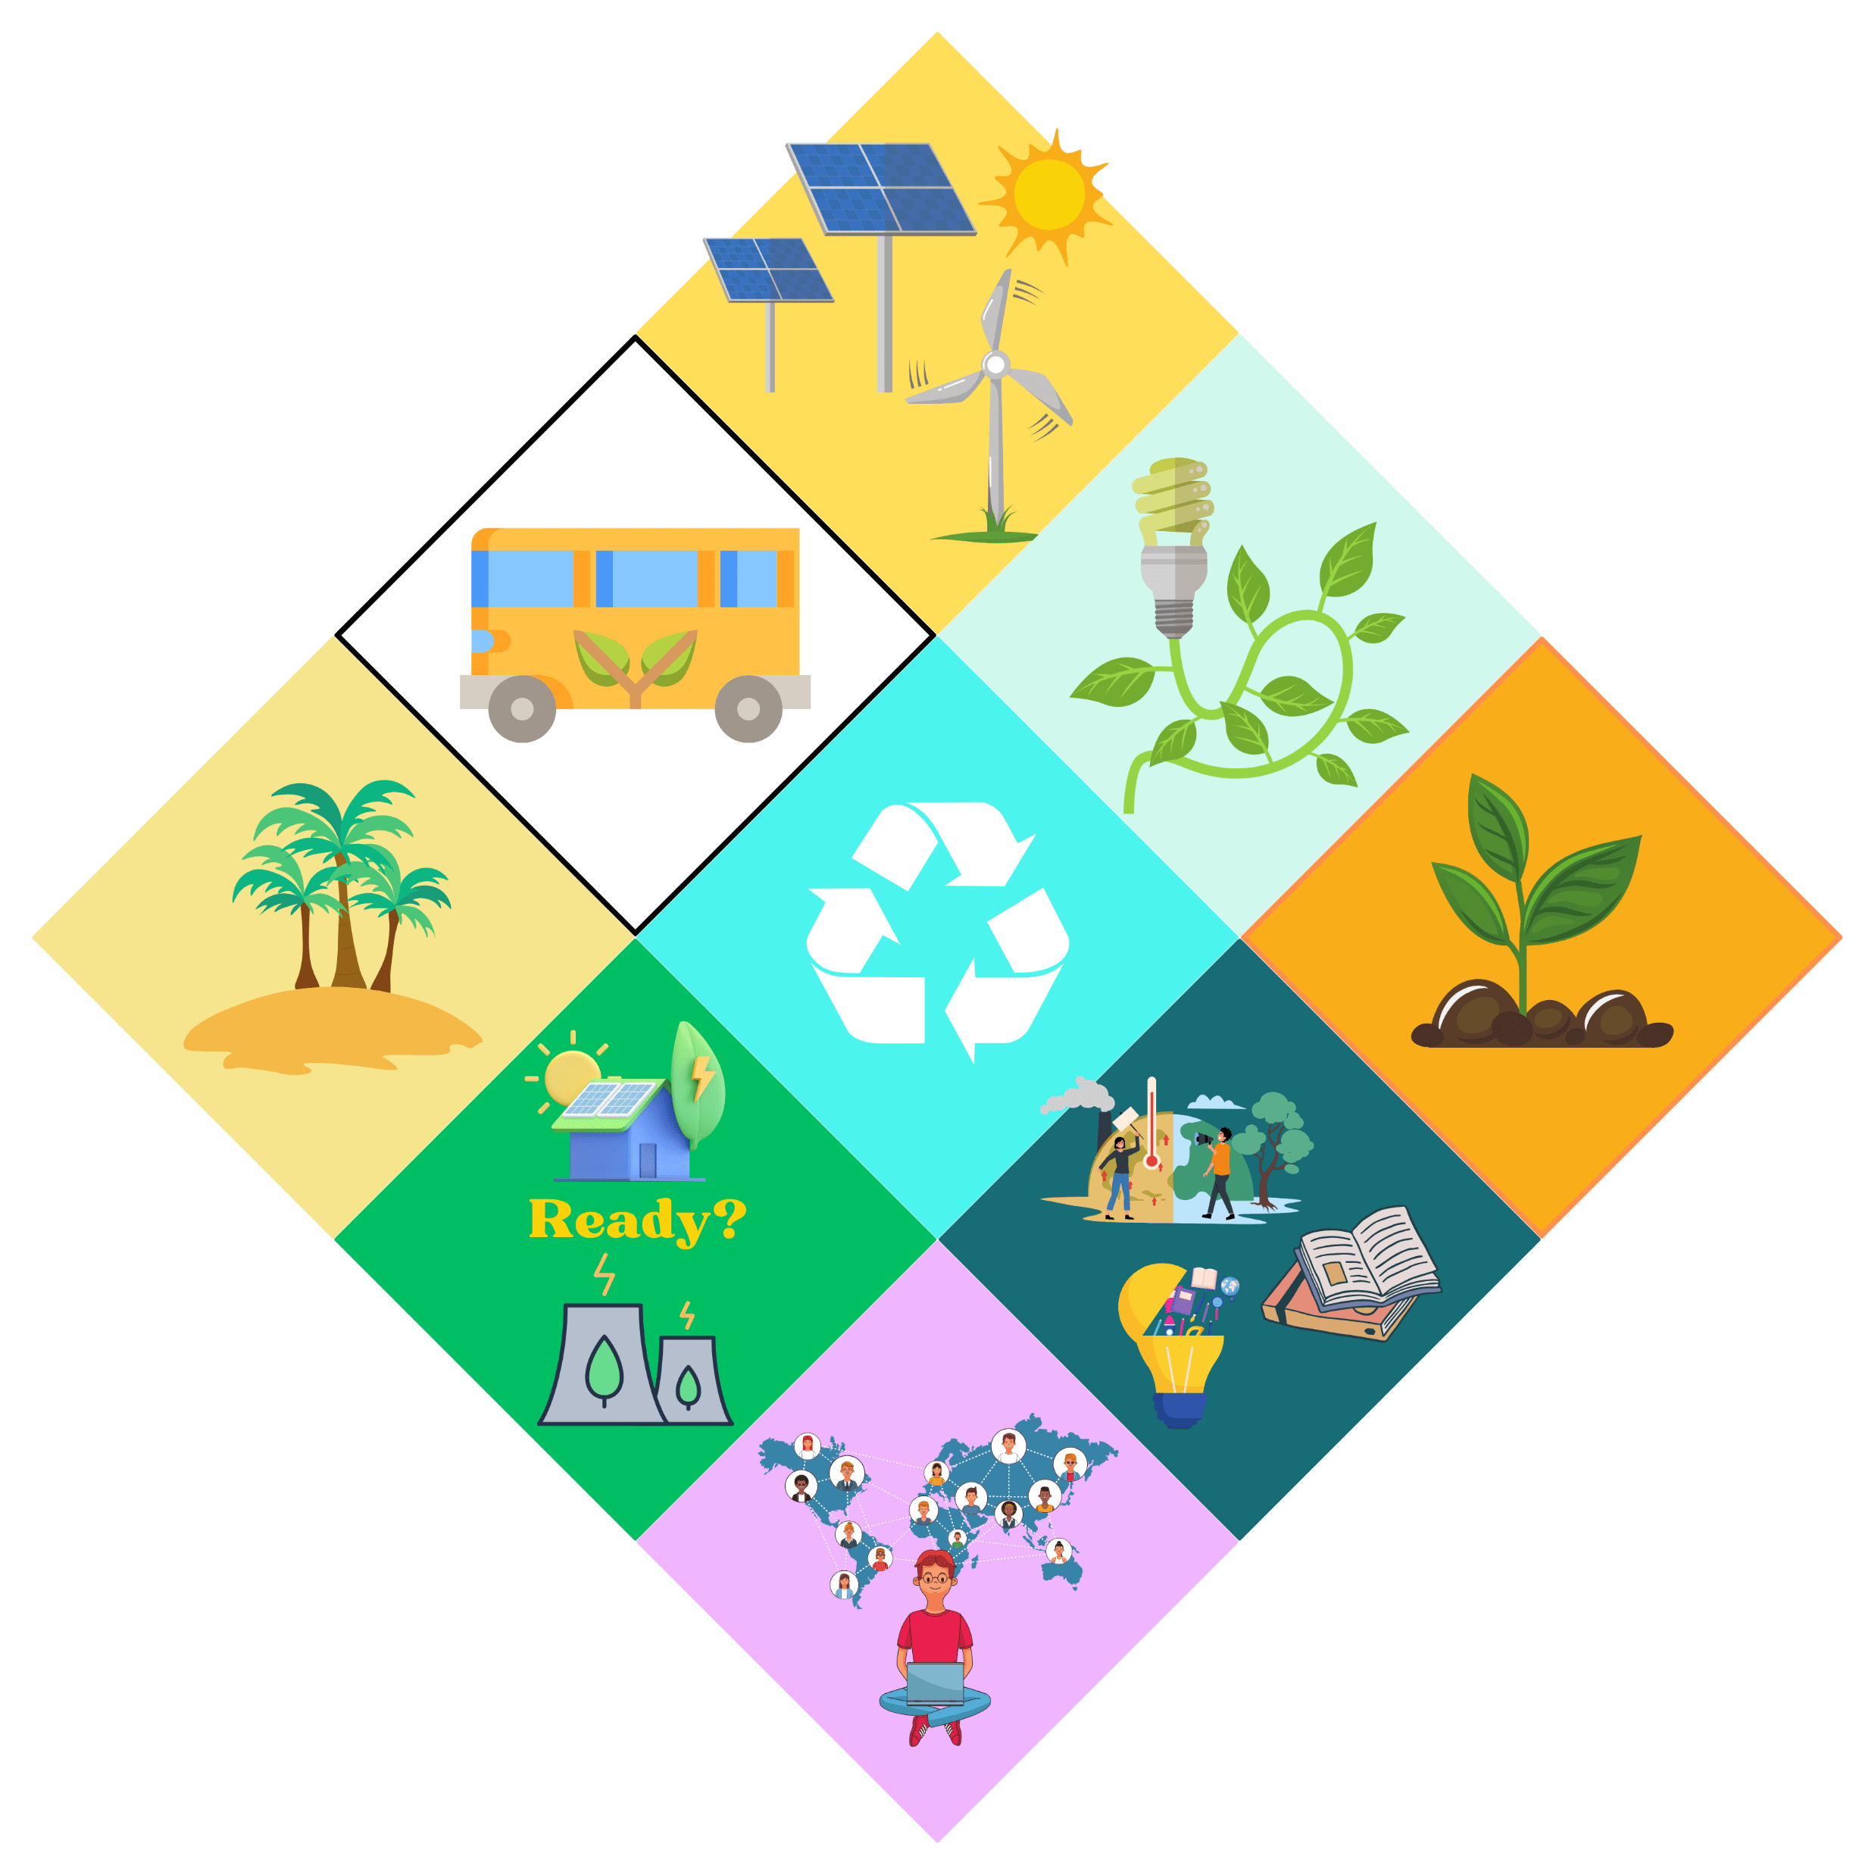
SP1
We have looked at 9 things that we could do as a society to prevent climate change or reduce its impacts.

Slide 24
SP1
Can you remember what they all are?

Slide 25
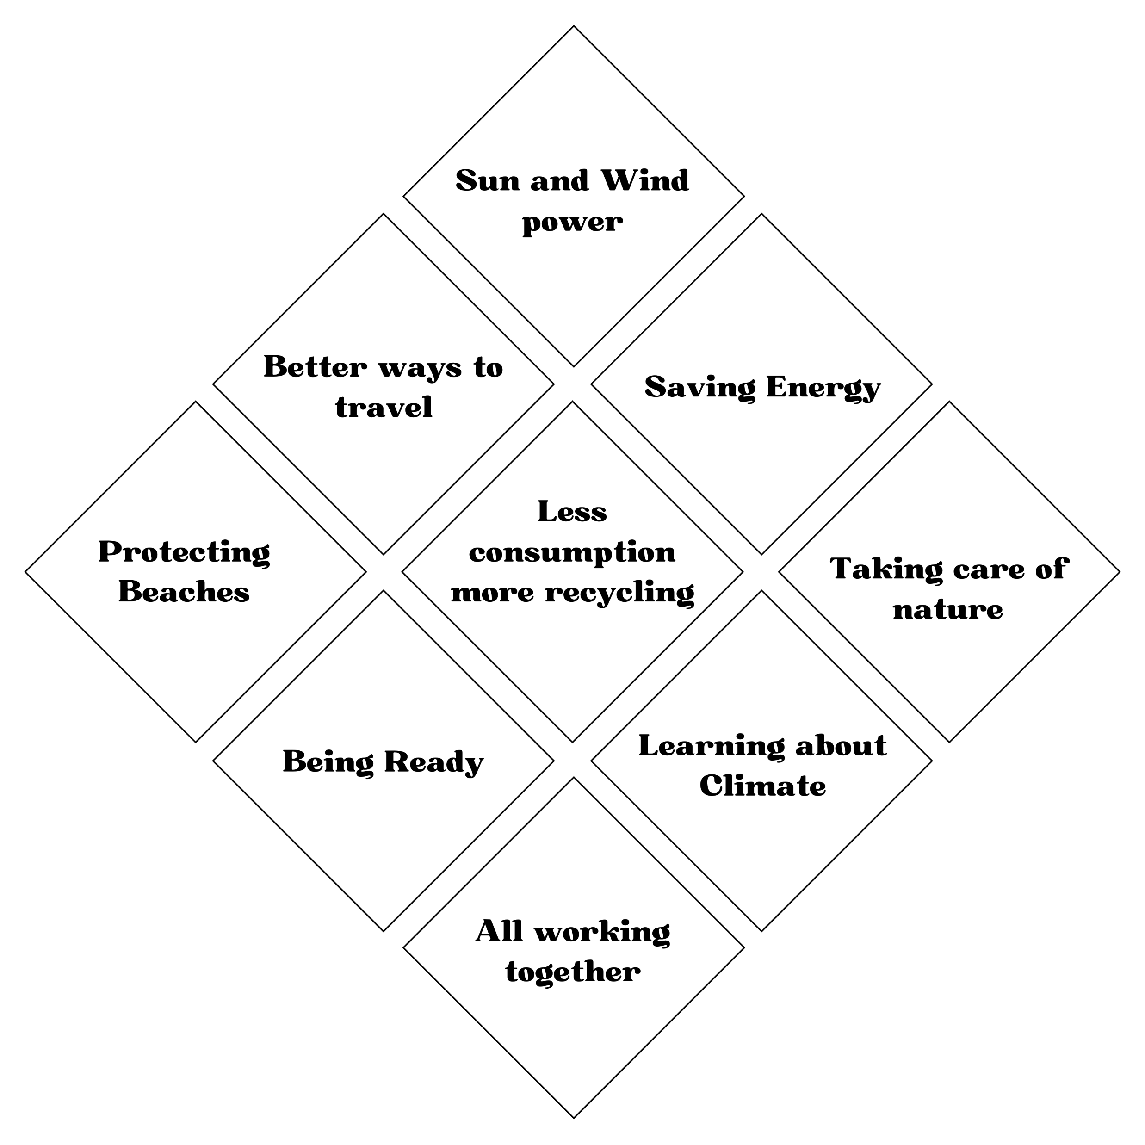
SP1
Notes:
Stress that these were things we could do as a WHOLE SOCIETY - these are the large scale / top-down things that will help.

Slide 26
SP1
There are 9 boxes.
It’s called a ‘Diamond 9’
Notes:
At this point the teacher MIGHT want to try the Diamond 9 and ask the class to choose their top three from these - probably a quick 30 second bit of pair work.

Slide 27
SP1
With your Diamond 9, you can:
Highlight your top 3
Or highlight your top one!
Notes:
Explain how the diamond 9 works:
9 = things that we have listed
3 = top three
1 - first choice.

Slide 28
SP1
Your Diamond 9!

Slide 29
SP1
Your task:
Your group will be given a different ‘version of us’
An individual
A family
A school
A community

Slide 30
SP1
Your group will have to answer the question:
“What can we do to reduce things that cause climate change and what actions could we take to respond effectively to it’s negative impacts?”
Find at least 9 things that you could do
Write them down
Choose the best 9
Put them in the Diamond 9
Notes:
At this point, the teacher will allocate the groups. As a group they will then need to decide upon the most appropriate causes of action they could take, whether as:
An individual; A family; A school; A community.
GIVE THE EMPTY DIAMOND TO THEM AS A HANDOUT.
This is a talking activity, and they should be given at least 10 minutes to get their Diamond 9 populated. They might want to start on individual whiteboards or pieces of paper and write down their own ideas first, to see whether there are some that they all agree on, and then open the discussion to find other things. Ideally, they will have more than 9 things, so they can start discussing which are more effective and which less so. The idea is that they need to explain, justify and qualify their answers to each other. Not to worry if they only come up with 9, because the next part will allow them to do that anyway.

Slide 31
SP1
Notes:
Leave this slide on the board when the groups are working out their own ideas - it will help them.

Slide 32
SP1
What do you think?
What have you come up with?
What are your ideas?
What are the best things we can do as:
An individual
A family
A school
A community
A society
Notes:
Listen to and write up the responses.
Probably start with the top three, then ask for the top one.
(This is a good opportunity to see what the rest of the class think. Teacher might ask for votes on the top one, having written down the top three. Establishing that there are differences of opinion and that none are ‘more right’ than others is very important. It feeds into the bigger picture that although there is consensus on the science, there is little consensus of what actions we all should take.)
Take lots of feedback from the class and leave with the idea that there is lots we could do.

Slide 33
SP1
Conclusion

Slide 34
SP1
…what will you do… as an individual?
Notes:
As you dismiss the class, you could ask them to tell you one thing they will do as they leave the classroom.
Or, you could give them a post-it note each and ask them to write one thing down that they will do. Don’t ask them to put their names on them.
You could put up the post-it notes in the classroom and ask them at a later date whether they managed it. Or what stopped them?
This reinforces the idea that words are easy and that actions are harder - it doesn’t quite hold them to account without any pointing of fingers, but it raises the idea of accountability.

Slide 35
SP1

