Slide 1
Introduction to Climate Change in Cayman
Lesson 2 | What is causing the climate to change?
Objective: To understand the main causes of climate change. To learn about the greenhouse effect and the carbon cycle, and how ecosystems can absorb and retain carbon e.g., seagrass and mangroves. | Criteria: After completing the previous lesson, the students should be able to discern the traits of ‘climate’ from ‘weather’ and have an idea of some of the ways in which climate change is impacting the world e.g., temperature rise and sea level rise etc.
Process: This class will be broken down into 3 parts: Carbon Cycle, the Greenhouse Effect and a class discussion. Part 1: Will look over the carbon cycle and other natural carbon sinks that we have here in the Cayman Islands, students will take part in an “image and statement” matching activity with a diagram they can add to. Part 2: This will be the chance to go over the greenhouse effect. Have the students think critically about how it might play into their carbon cycles and how human activities may impact it. Class Discussion: These questions could be discussed as a class or could be used as an assessment point for students to answer on their way out of class.
Resources: Carbon Cycle diagram handout Images and statement cutouts Presentation Lesson Plan | Notes: Teachers should print out overview of slide show, including the notes for each slide. This will help the lesson flow. The lesson plan can be used in conjunction with the slide show, or the slide show could be used as the plan itself.

Slide 2
Introduction to Climate Change in Cayman (Mini Unit): Lesson 2
What is causing the climate to change?

Slide 3
The Carbon Cycle
Introduction
The Greenhouse Effect
Discussion

Slide 4
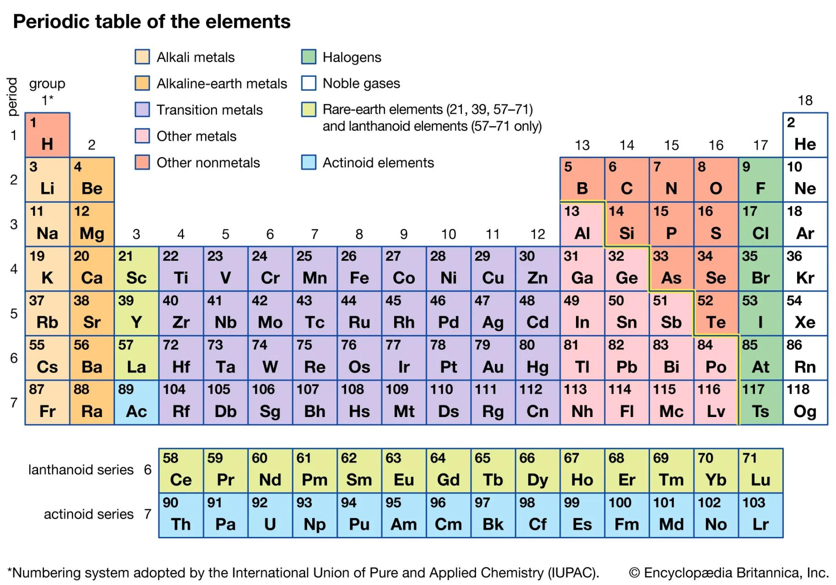
Carbon is a vital element for most living organisms on Earth and is a key component of our atmosphere.

Slide 5
Carbon cycles through the ocean, soil, plants, animals, and the air.
The is called the Carbon Cycle.

Slide 6
Carbon is found in the atmosphere in at least 2 forms:
CO_{²}
O
H
H
C
C
O
CH₄
H
H

Slide 7
Otherwise known as:
Carbon Dioxide
O
H
H
C
C
O
Methane
H
H

Slide 8
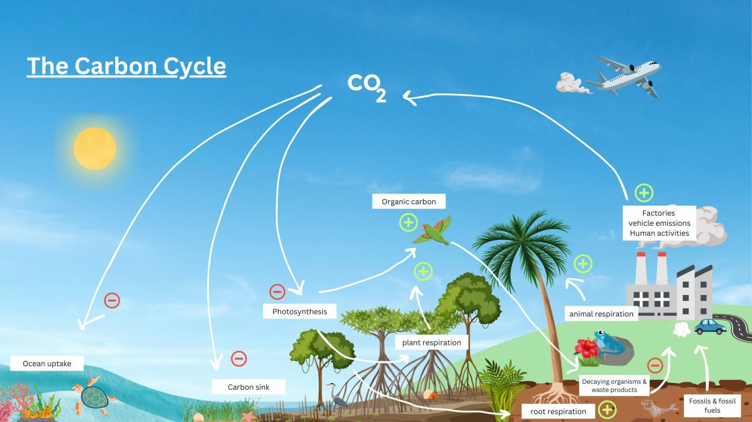
Combustion
Notes:
Explain the carbon cycle in its most basic form. Use the diagram and arrows to show carbon in and carbon out.
Carbon sinks: A carbon sink absorbs carbon dioxide from the atmosphere. The ocean, soil and forests are the world's largest carbon sinks. Other then the ocean, forest and soil, we have two major carbon sinks in the Cayman Islands: Seagrass beds and mangroves. We need to protect these sinks.

Slide 9
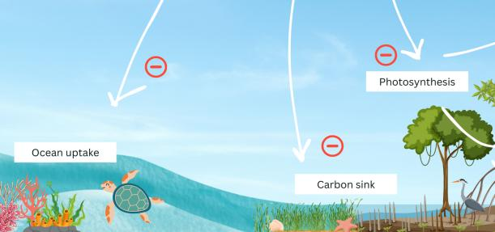
In the ocean: Carbon dioxide is absorbed by the ocean and reacts to create carbonic acid.
Carbon Sinks
A carbon sink absorbs carbon dioxide from the atmosphere. Our seagrass beds and mangroves are some of the best carbon sinks on EARTH, along with the ocean, forests and soil.
Notes:
Explain the carbon cycle in its most basic form. Use the diagram and arrows to show carbon in and carbon out.
Carbon sinks: A carbon sink absorbs carbon dioxide from the atmosphere. The ocean, soil and forests are the world's largest carbon sinks. Other then the ocean, forest and soil, we have two major carbon sinks in the Cayman Islands: Seagrass beds and mangroves. We need to protect these sinks.

Slide 10
Photosynthesis: Carbon dioxide is absorbed by plants during photosynthesis.
Respiration: Carbon is released by animals when they breathe (cellular respiration). It is also released during root respiration when they take up nutrients for growth and maintenance.
Waste & decay: Animals release carbon (methane) during digestion as waste. After animals and plants die, the carbon in their bodies is absorbed into the ground.
Notes:
Explain the carbon cycle in its most basic form. Use the diagram and arrows to show carbon in and carbon out.

Slide 11
Fossils & Fossil Fuels: When the animals die, they decompose, and their remains become sediment, trapping the stored carbon in layers that eventually turn into rock or minerals. Some of this sediment might form fossil fuels, such as coal, oil, or natural gas.
Factories/Human activities: To create energy, we dig up these fossil fuels and burn them (combustion) to power our factories, homes, cars, planes etc. which releases this carbon (CO_{²}) back into the atmosphere.
Combustion
Notes:
Explain the carbon cycle in its most basic form. Use the diagram and arrows to show carbon in and carbon out.

Slide 12
Combustion
Notes:
Highlight to the students how this is a circular cycle that goes around and around.

Slide 13
The Carbon Cycle

Slide 14
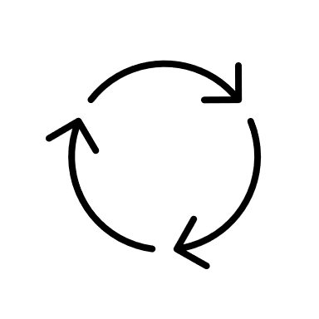
The Carbon Cycle Activity:
In your groups:
Match the images to the statements relating to the natural carbon cycle (we will come back to factories and human activities!)
Place these pairs on your paper and use your pens and pencils to draw the arrows of the cycle and add any additional elements you think necessary.
Notes:
Pt 1 Carbon Cycle (10 mins)
Distribute a large sheet of paper to each group of students.
Hand out a set of printed images and statements related to the natural carbon cycle. Each of these images or statements should be directly related to steps in the cycle.
Instruct students to place images and statements on their paper to illustrate the carbon cycle. They should use markers to draw arrows or add any additional elements they think are necessary.

Slide 15
Share and compare!
Notes:
Once groups have completed their diagrams, Stop to discuss - Ask a student to review the cycle they created - Check for understanding.
Next – we are going to add in the impacts of the greenhouse effect.

Slide 16
The Greenhouse Effect

Slide 17
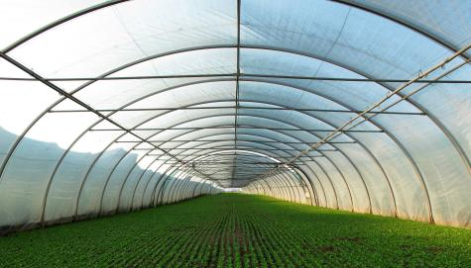
What is the Greenhouse Effect?
Notes:
See if any of the students can explain before beginning.

Slide 18
Draw arrows to show how some of the sun's radiation enters the Earth’s atmosphere and gets absorbed by the Earth, while other rays are reflected, and others trapped by greenhouse gases.
Notes:
Introduce the greenhouse effect by providing images of the sun, Earth, and greenhouse gases. Ask students to depict how the sun's rays enter the Earth's atmosphere, get absorbed by the Earth, and are then re-emitted, with some being trapped by greenhouse gases.
Either use smartboard pens to draw arrows or draw this simple diagram on the board and allow the students to directly add to the diagram.

Slide 19
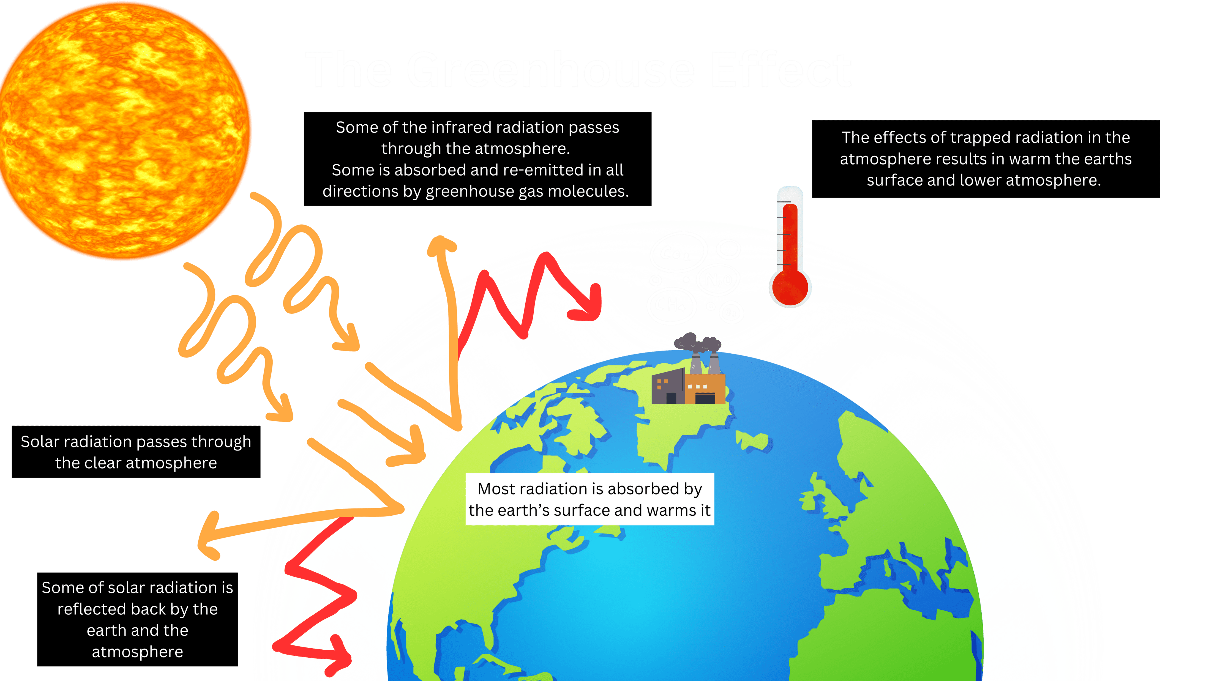

Slide 20
What do you think might happen if we keeping pumping carbon and other greenhouse gases into the atmosphere?
Notes:
Elicit from the students, the idea that more carbon will lead to more reflected heat being trapped within the Earth’s atmosphere.
Next: How will the increase in carbon disrupt our carbon cycle?

Slide 21
Let’s think about the Greenhouse Effect in terms of the Carbon Cycle…

Slide 22
After learning about the greenhouse effect, what is one way we might be disrupting this carbon cycle?
Notes:
Our human activities, like digging up fossil fuels and using them to generate energy and power our lives, adds more carbon into the environment than was already being added naturally. This disrupts the carbon cycle as there is now more carbon than normal being taken up by the ocean etc.
We are also destroying and removing some of our natural sinks e.g. the rainforest, mangroves and seagrass beds, so there are fewer and fewer ways for this carbon to be absorbed naturally.

Slide 23
What natural occurrences could happen that would cause disruption?
Notes:
Volcanic eruptions add more carbon to the atmosphere
Forest fires

Slide 24
What human activities will add or take away carbon from the system?
Notes:
Add:
Burning fossil fuels
Deforestation (fewer trees means less carbon can be absorbed)
Rapid Development
Industrial activities
Rapid expansion of farming and agricultural land
Removing other carbon sinks like mangroves and seagrass
7. Dump fires, as we get here in Cayman from time to time
Take away:
Conserving natural spaces
Planting more trees, forest restoration
Conserving and planting mangroves
Seaweed farms – the seaweed captures the carbon during its photosynthesis while also providing a natural habitat for fish and other ocean animals.
New carbon capture technology

Slide 25
Add the additional images and statements to your cycles to include human activities and their impacts.
Think about this:
How will this change your diagram?
What impact would this have, other than more carbon in the atmosphere?
Notes:
Distribute the additional images and statements that depict human activities and their impact on the carbon cycle.
Students should integrate these new elements into their existing diagrams, showing how human activities add more carbon dioxide to the cycle (ex - burning of fossil fuels etc.). These might include new arrows, annotations, bits of text and other information being added to the diagram.
Give them 5-10 minutes for this.

Slide 26
Share and compare with your neighbour
Notes:
Allow groups to share their diagrams with the class, explaining their understanding of the carbon cycle, the greenhouse effect, and human impact.
Optional Observation Break - This could be done as a ‘gallery walk’ before all groups have finished so that they can see what other groups are doing and incorporate their ideas into their own models. They can also leave a post-it note with feedback on other groups' work.

Slide 27
Discussion

Slide 28
Let’s finish by thinking about these questions:
How do human activities disrupt the natural balance of the carbon cycle?
Why is it important to understand the relationship between the carbon cycle and the greenhouse effect?
What are some ways we can reduce our carbon footprint and lessen our impact on the carbon cycle?
Notes:
These questions could be usefully discussed first as a class. The lesson might finish with the students answering these questions in writing AFTER the class discussion as an exit ticket (assessment opportunity).

