Slide 1
Introduction to Climate Change in Cayman Mini Unit
Lesson 3 | What is the History of the Earth’s Climate and how do we know?
Objective: Students will explore the long-term patterns of climate change on Earth, focusing on the correlation between CO₂ and temperature. By the end of the lesson, they should be able to identify patterns and understand the significance of historical climate data. | Criteria: After completing this lesson, students should understand how important historical data is for looking back at our climate’s history, track our progress and predicting our future. They will also learn the complexities of correlation vs causation, the Keeling Curve and the Industrial Revolution.
Process: Introduction: Elicit answers from the class to the question “How can we know about the history of the climate?” Activity 1: 4-part presentation starting with historical temperature data analysis, predicting CO₂ levels, ice core videos, comparing predictions with actual CO₂ data. Activity 2: Introduce the Keeling Curve and the Industrial Revolution Conclusion: Compare and share between students
Resources: Presentation CO₂ Graphs Temperature Graphs Keeling Curve Graphs Keeling Curve worksheet Ice Core video | Notes: Teachers should print out overview of slide show, including the notes for each slide. This will help the lesson flow. The lesson plan can be used in conjunction with the slide show, or the slide show could be used as the plan itself

Slide 2
Introduction to Climate Change in Cayman (Mini Unit): Lesson 3
What is the History of the Earth’s climate and how do
we know?

Slide 3
Data Analysis
Predicting CO2 Levels
Introduction
Ice Core Video
Causation vs Correlation
The Keeling Curve

Slide 4
Introduction

Slide 5
How do we know about the history of the climate?
Notes:
Elicit responses, guiding students to two main answers:
Direct measurements (current temperature, atmospheric gasses, etc.)
Indirect evidence from times before human record-keeping (chemical and structural signatures in rocks, fossils, crystals, ocean sediments, tree rings, fossilized reefs, etc.)

Slide 6
Sea and tide levels
Current temperatures
Directly recorded measurements
Atmospheric gases
Rainfall and weather patterns
Notes:
Direct measurements (current temperature, atmospheric gases, etc.)
Indirect evidence from times before human record-keeping (chemical and structural signatures in rocks, fossils, crystals, ocean sediments, tree rings, fossilized reefs, etc.)

Slide 7
Rocks, fossils and crystals
Ice cores
Indirect evidence from times before human record-keeping
Ocean sediments and fossilized reefs
Tree rings
Notes:
Direct measurements (current temperature, atmospheric gases, etc.)
Indirect evidence from times before human record-keeping (chemical and structural signatures in rocks, fossils, crystals, ocean sediments, tree rings, fossilized reefs, etc.)

Slide 8
Historical Temperature Data Analysis

Slide 9
Historical Temperature Data Analysis Activity:
You will be divided into small groups, and each given a graph showing historical temperature data from 800,000 years ago!
You will discuss the patterns on the graph in your groups and come up with:
Three statements about the data
Three “How/Why” questions about the data
Notes:
10 minutes
Divide the class into small groups and provide each group with historical temperature data. (800,000 yrs).
Instruct students to discuss patterns they observe in the data.
Each group should formulate three statements about the data they're examining.
Each group should formulate three "How/Why" questions about the data they're examining.
The takeaway should be the understanding that ‘CO₂ and temperature are closely correlated’.

Slide 10
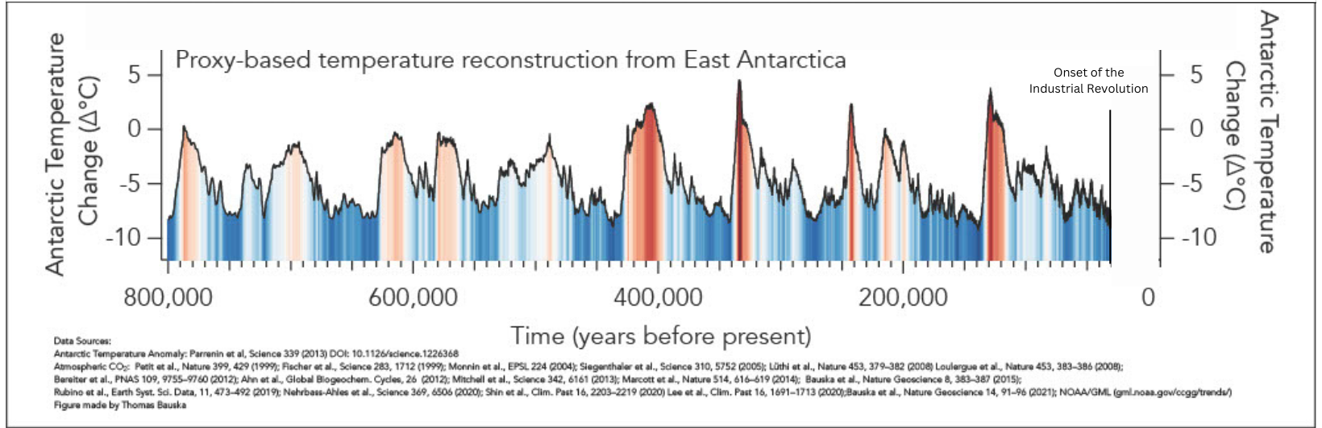
Three statements about the data
Three “How/Why” questions about the data
Notes:
Divide the class into small groups and provide each group with historical temperature data (800,000 yrs).
Instruct students to discuss patterns they observe in the data.
Each group should formulate three statements about the data they're examining.
Each group should formulate three "How/Why" questions about the data they're examining.

Slide 11
Predicting CO_{²} Levels

Slide 12
Think about what you know about the Greenhouse Effect and the links between greenhouse gases and temperature…
Notes:
Predicting CO₂ Levels :
Based on the temperature data, each group should make a prediction about what CO₂ levels might look like over the same period.
They should sketch their prediction directly onto the temperature graph.

Slide 13
Based on what you know, what prediction can you make about what CO_{²} levels might look like over the same period?
Notes:
5 minutes
Based on the temperature data, each group should make a prediction about what CO₂ levels might look like over the same period.
They should sketch their prediction directly onto the temperature graph.

Slide 14
Sketch your prediction directly onto the temperature chart
British Antarctic Survey, National Environment Research Council
Notes:
5 minutes

Slide 15
Sketch your prediction directly onto the temperature chart
Example:
British Antarctic Survey, National Environment Research Council
Notes:
5 minutes

Slide 16
Ice Cores

Slide 17
What are Ice Cores and how do they provide a record of Earth’s past climate?
Notes:
Allow students to guess before the video if they would like.
Show a video (3 mins) about ice core samples, explaining how they provide a record of past CO₂ levels.

Slide 18
Notes:
Show a video about ice core samples, explaining how they provide a record of past CO₂ levels.

Slide 19
Causation vs Correlation

Slide 20
After watching the video, how did your predictions match the actual data?
Note any similarities or differences
Notes:
15 mins
Distribute the actual CO₂ data from ice core samples to each group.
Students should compare their predictions with the actual data, noting similarities and differences.
Provide groups with a worksheet containing questions about the data comparisons. This worksheet should guide them in understanding the relationship between temperature and CO₂ levels, and one of the questions should be designed to help them grasp the concept of correlation vs. causation

Slide 21
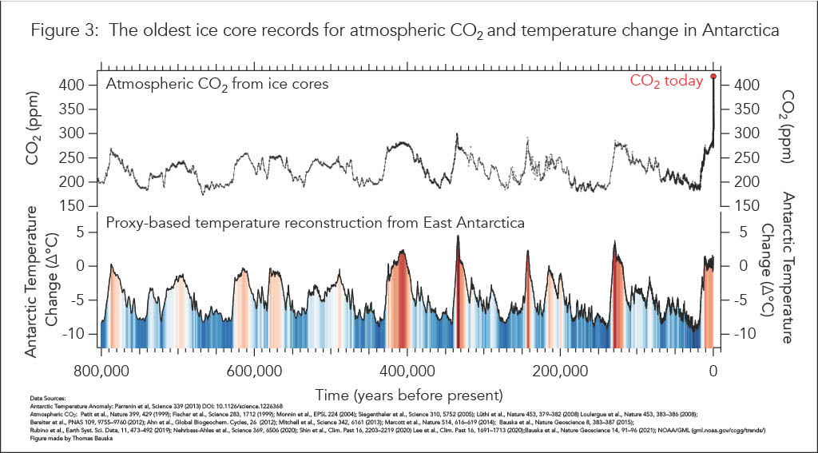
British Antarctic Survey, National Environment Research Council
Notes:
5 mins
Distribute the actual CO₂ data from ice core samples to each group.
Students should compare their predictions with the actual data, noting similarities and differences.

Slide 22
What is Correlation vs Causation?
Notes:
Correlation vs Causation

Slide 23
What is Correlation vs Causation?
Correlation
When two things seem to be connected or related to each other, meaning that when one changes, the other often changes too. It's like noticing a pattern or a connection between two things happening at the same time. However, it's important to remember that just because two things are correlated doesn't mean that one causes the other.
Notes:
Correlation vs Causation

Slide 24
What is Correlation vs Causation?
There are 2 kinds of correlations:
Positive and Negative
Notes:
Correlation vs Causation
Positive Correlation: A positive correlation is when two things go up or down together. In other words, as one thing increases, the other also increases, and as one thing decreases, the other also decreases. Imagine a line going up diagonally on a graph – that's what a positive correlation looks like. So, if you notice that when one thing goes higher, the other tends to go higher too, you've got a positive correlation.
Negative Correlation: A negative correlation is like a seesaw – when one thing goes up, the other tends to go down, and when one thing goes down, the other tends to go up. In simpler terms, it's when two things move in opposite directions. If you see a line on a graph going down diagonally, that represents a negative correlation. So, when one thing increases, the other tends to decrease, and vice versa.

Slide 25
What is Correlation vs Causation?
A Positive correlation is when two things go up or down together
So, in this case, we can see that when temperature goes up, so too does CO₂. They are positively correlated.
Notes:
Correlation vs Causation
Positive Correlation: A positive correlation is when two things go up or down together. In other words, as one thing increases, the other also increases, and as one thing decreases, the other also decreases. Imagine a line going up diagonally on a graph – that's what a positive correlation looks like. So, if you notice that when one thing goes higher, the other tends to go higher too, you've got a positive correlation.
Negative Correlation: A negative correlation is like a seesaw – when one thing goes up, the other tends to go down, and when one thing goes down, the other tends to go up. In simpler terms, it's when two things move in opposite directions. If you see a line on a graph going down diagonally, that represents a negative correlation. So, when one thing increases, the other tends to decrease, and vice versa.

Slide 26
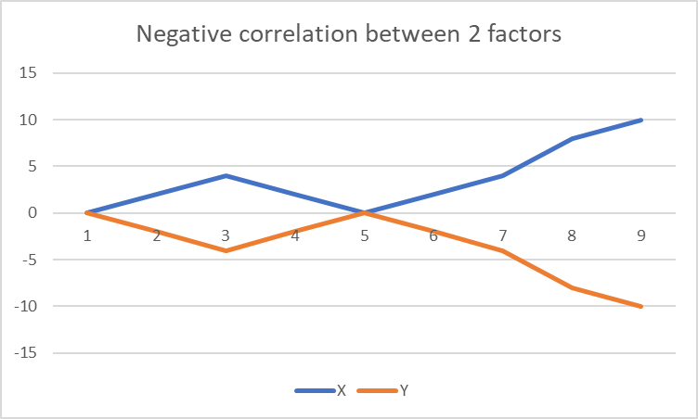
What is Correlation vs Causation?
A Negative correlation is like a seesaw – when one thing goes up, the other tends to go down, and when one thing goes down, the other tends to go up.
So, in this case, we can see that when X goes up, Y goes down.
They are negatively correlation.
Notes:
Correlation vs Causation
Positive Correlation: A positive correlation is when two things go up or down together. In other words, as one thing increases, the other also increases, and as one thing decreases, the other also decreases. Imagine a line going up diagonally on a graph – that's what a positive correlation looks like. So, if you notice that when one thing goes higher, the other tends to go higher too, you've got a positive correlation.
Negative Correlation: A negative correlation is like a seesaw – when one thing goes up, the other tends to go down, and when one thing goes down, the other tends to go up. In simpler terms, it's when two things move in opposite directions. If you see a line on a graph going down diagonally, that represents a negative correlation. So, when one thing increases, the other tends to decrease, and vice versa.

Slide 27
BUT just because two things may be positively or negatively correlated, it does not mean that one caused the other to change…

Slide 28
To prove that one thing causes another thing, we must run tests on both things and observe if there is a direct connection, if one thing directly makes another thing change.
For example…

Slide 29
This shows that more time spent studying will cause you to do better in your exam, and vice versa, the less time you spend, the less well you will do.
The more time I spend in preparing for my exam, the better the grades I will get, in almost all cases.
These 2 things are positively correlated and there is causality.

Slide 30
Causation
Causation is when one thing makes another thing happen. It's the reason why something happens because of something else. Imagine if you eat healthy food and feel strong – healthy food causes you to feel strong. But be careful, just because two things happen together doesn't always mean one caused the other, so we need to investigate more to be sure.

Slide 31
Just because these 2 things are correlated, does not mean that one has caused the other.
Let’s try a different example:
When the sun rises in the morning, the rooster outside my window crows - these 2 things are correlated.
If rooster one day decides not to crow outside the window, will the sun not rise?
We have correlation between these 2 things, but no causation!

Slide 32
The Keeling Curve

Slide 33
The Keeling Curve
Notes:
Start the video at 0.57 seconds and either play until end or until 5.15 mins

Slide 34
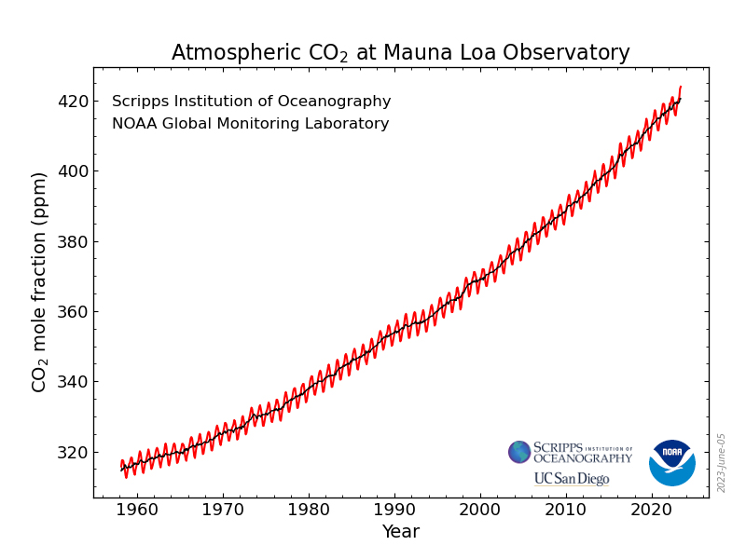
Historical data can help us to better understand our planet’s past
Graph from the National Oceanic and Atmospheric Administration
Notes:
As a class, discuss what this data means for the climate, based on the historical data.

Slide 35
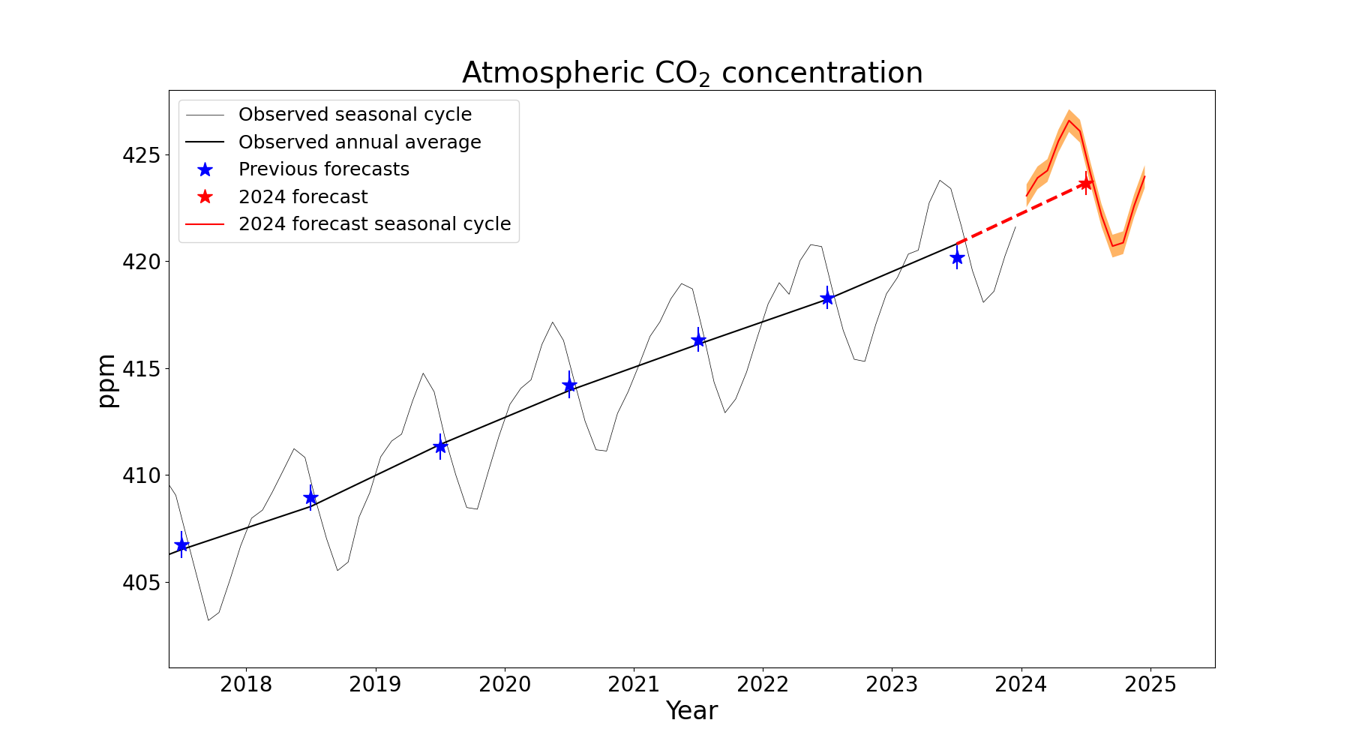
www.metoffice.gov.uk
Notes:
Forecast CO₂ concentrations at the Mauna Loa Observatory. The orange band and vertical red line shows the forecast ranges. The thin and thick black lines show the observed monthly and annual average concentrations, respectively. Blue stars show previous forecast annual averages. Observed data is from the Scripps Institution of Oceanography, UC San Diego.

Slide 36
It can also help us predict the future with reasonable means of certainty
www.metoffice.gov.uk
Notes:
Forecast CO₂ concentrations at the Mauna Loa Observatory. The orange band and vertical red line shows the forecast ranges. The thin and thick black lines show the observed monthly and annual average concentrations, respectively. Blue stars show previous forecast annual averages. Observed data is from the Scripps Institution of Oceanography, UC San Diego.

Slide 37
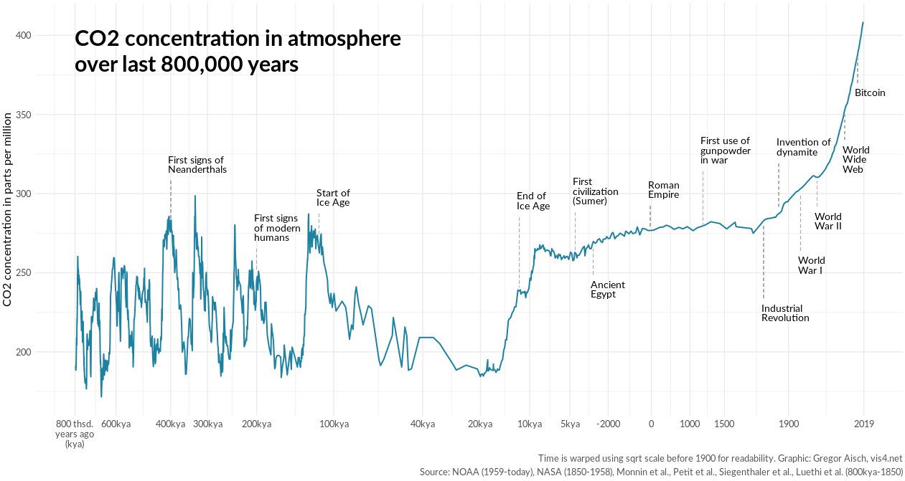
Notes:
Note to students that the time scale on this graph is not uniform (it uses a square rot scale before 1900 for readability) and that this has happened over many thousands of years.
Take them through time up until current day and ask them where they think a rapid increase in CO₂ began – the onset of the Industrial Revolution

Slide 38
But why did CO₂ start to rapidly increase in the first place?
Notes:
Discuss the causation of increased CO₂ - the Industrial Revolution - burning fossil fuels and cutting down forests.

Slide 39
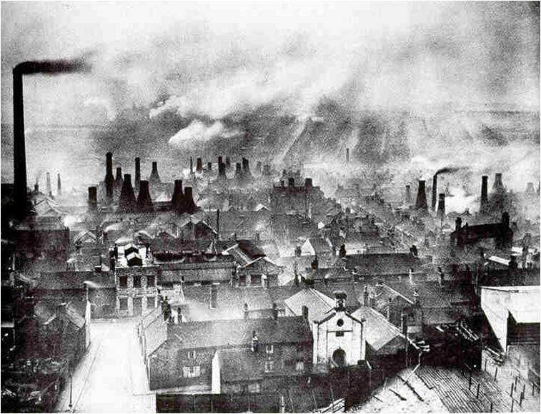
The Industrial Revolution
This Photo by Unknown Author is licensed under CC BY-SA-NC

Slide 40
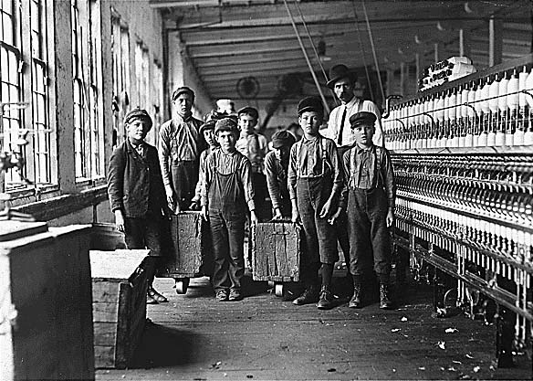
When It Started: The Industrial Revolution, a pivotal period in history, unfolded roughly two centuries ago, spanning the late 18th to early 19th centuries. This transformative era originated primarily in the United Kingdom.
This Photo by Unknown Author is licensed under CC BY-SA

Slide 41
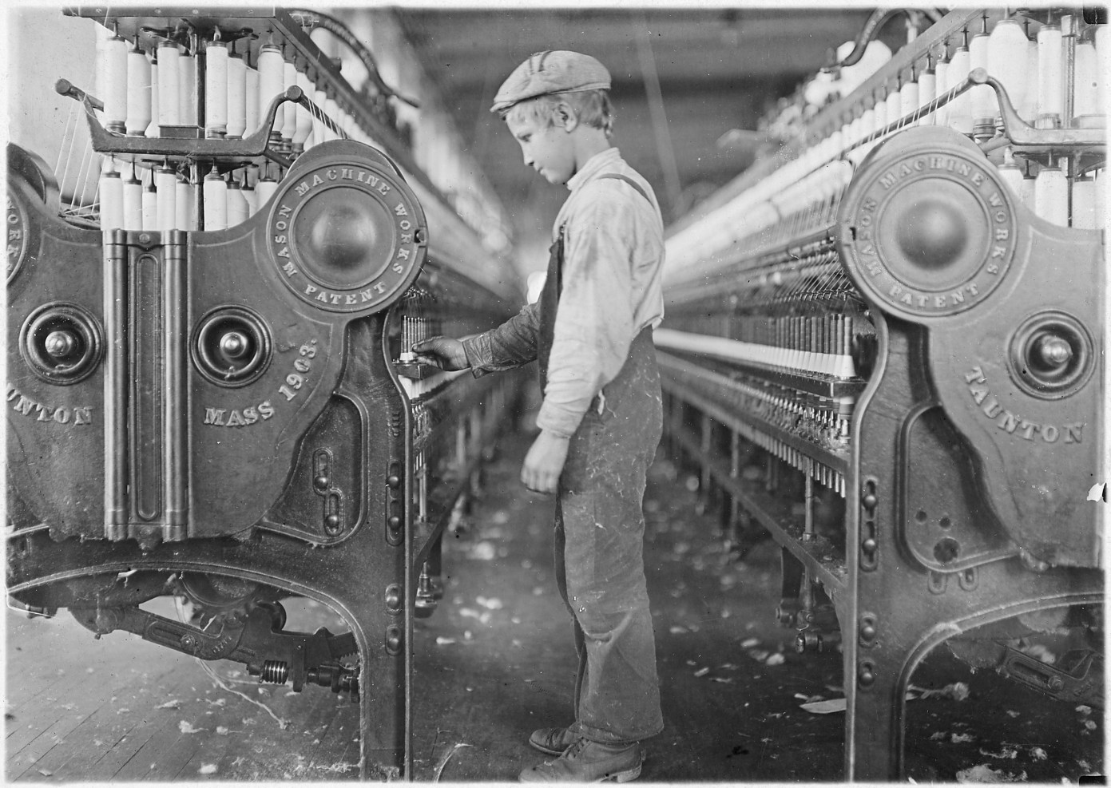
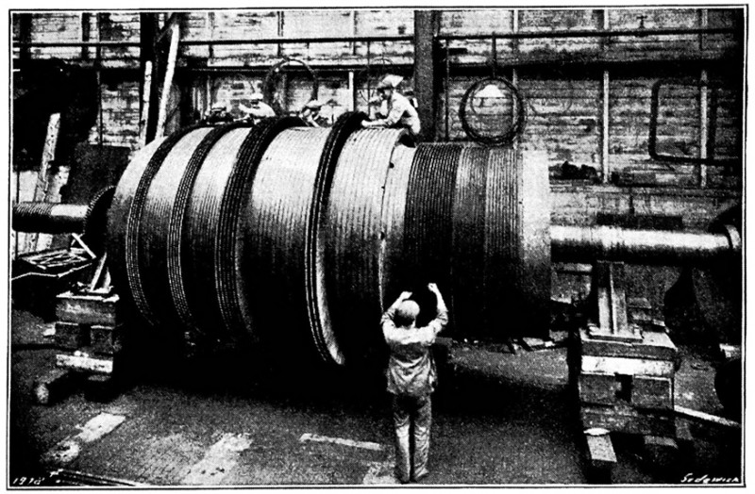
New Machines: At the heart of the Industrial Revolution were groundbreaking technological advancements. These machines, like the steam engine and spinning jenny, helped make things faster and better.
This Photo by Unknown Author is licensed under CC BY-NC
This Photo by Unknown Author is licensed under CC BY

Slide 42
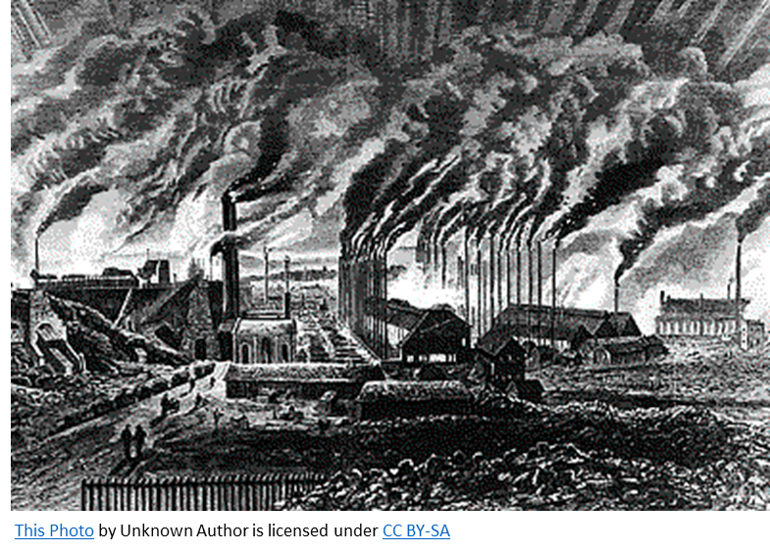
Climate Implications: The Industrial Revolution significantly impacted the climate through heightened greenhouse gas emissions.
The widespread use of fossil fuels, particularly coal, to power machinery resulted in substantial carbon dioxide emissions. This marked the onset of human-induced climate change, influencing global temperatures and weather patterns.

Slide 43
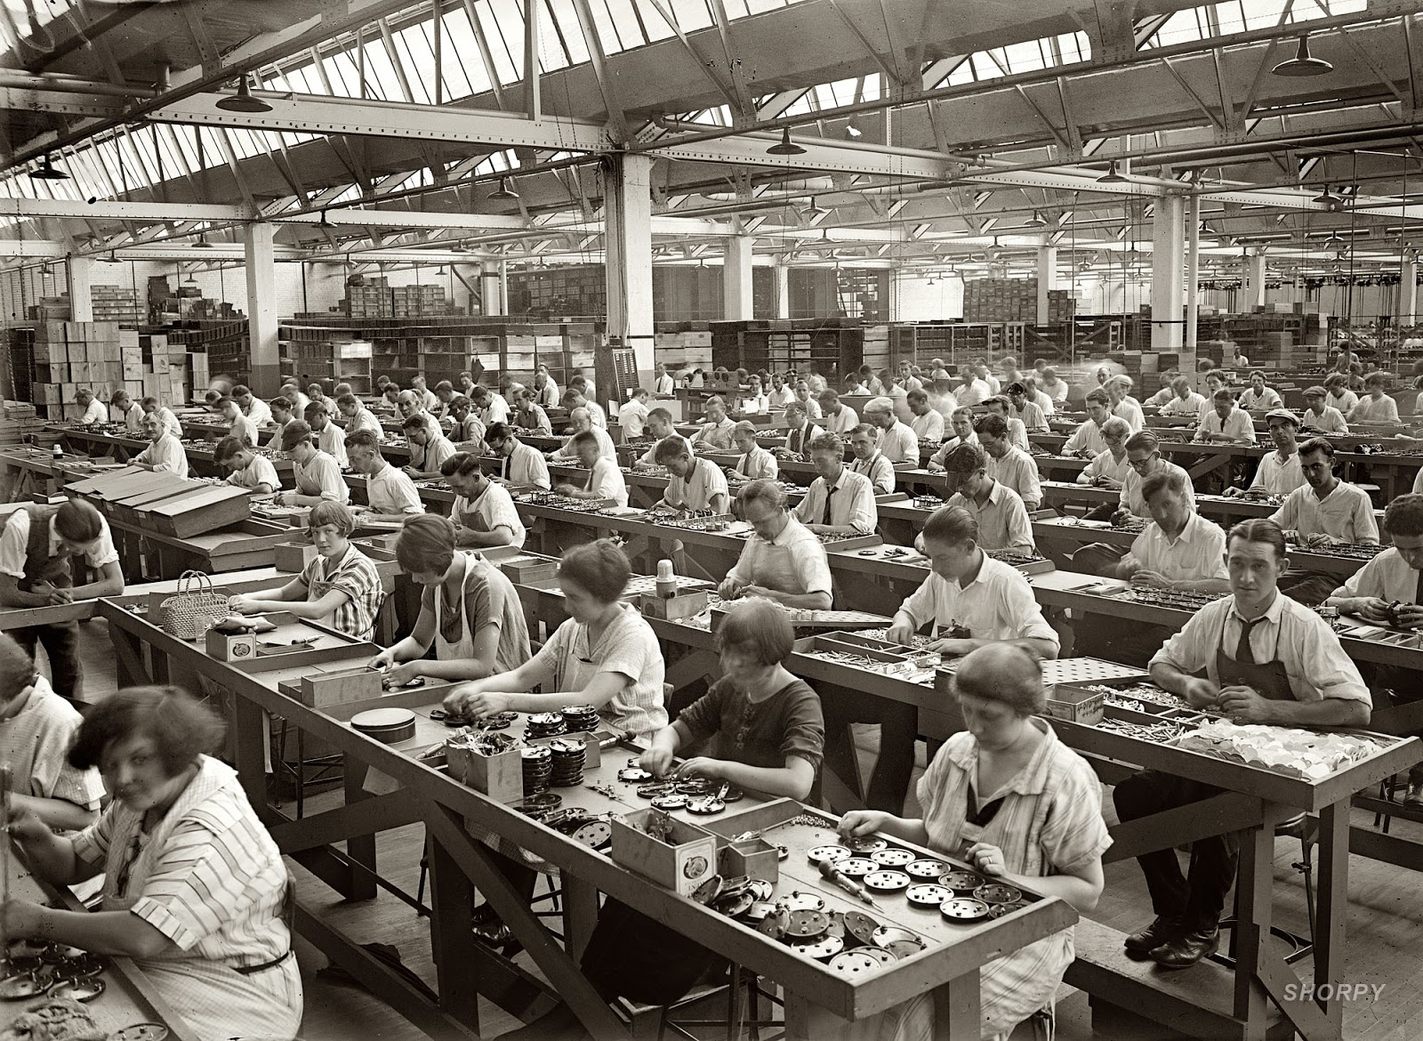
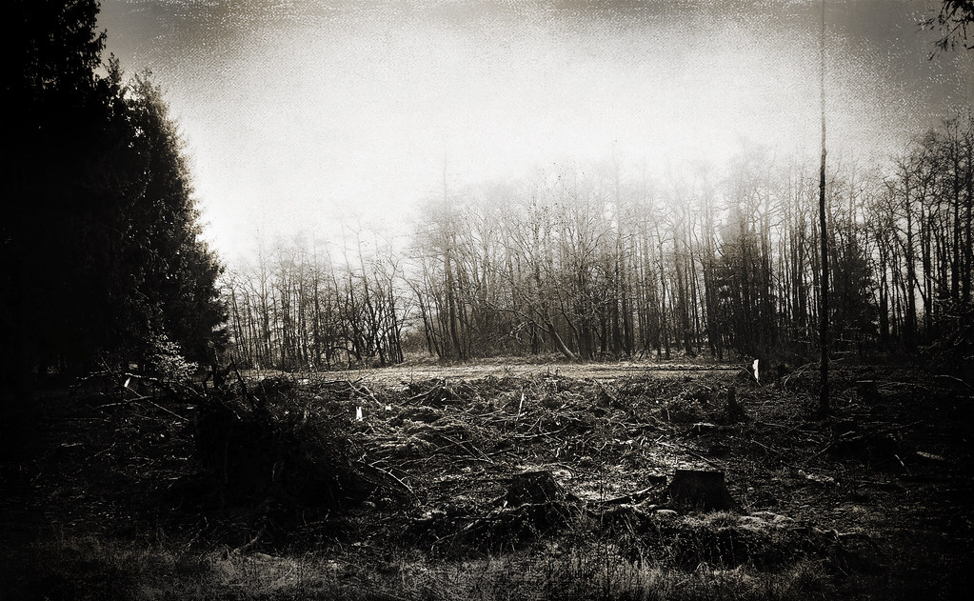
Not Only Good Stuff: Even though the Industrial Revolution brought new machines that improved people’s lives and helped to shape the world we enjoy today, it also caused many problems. People had to work in crowded and dirty places, and the air and water became polluted. Cutting down trees also changed the environment. So, while it was good in many ways, it also had some harmful consequences.
This Photo by Unknown Author is licensed under CC BY-SA-NC
This Photo by Unknown Author is licensed under CC BY-ND

Slide 44
Now looking back at this graph, we understand how much the Industrial Revolution impacted CO₂ levels in the atmosphere…

Slide 45
…and how the Keeling Curve came to be!
Notes:
Reminder - The Keeling Curve is a graph of the accumulation of carbon dioxide in the Earth's atmosphere based on continuous measurements taken at the Mauna Loa Observatory on the island of Hawaii from 1958 to the present day. The curve is named for the scientist Charles David Keeling, who started the monitoring program and supervised it until his death in 2005.

Slide 46
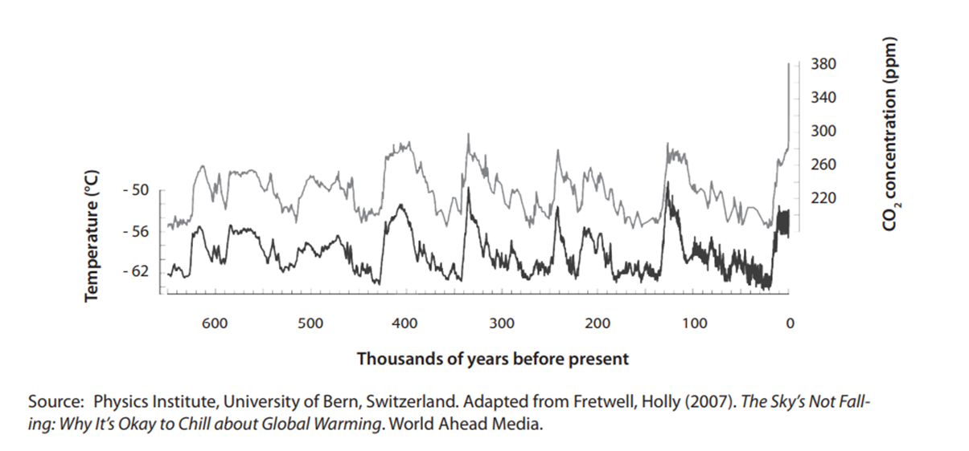
Thinking back to correlation vs causation…
When it comes to the correlation between temperature and CO₂, we can see a positive correlation…
Notes:
Distribute the worksheet and give the students 10 minutes to jot down their answers

Slide 47
Thinking back to correlation vs causation…
When we think about the causation, we have evidence that can help us argue causation:
Greenhouse gases in the atmosphere trap heat. CO₂ is a known greenhouse gas.
The burning of fossil fuels release CO₂ in our atmosphere
The more greenhouse gases in the atmosphere, the more heat is trapped.
The more heat trapped; the warmer average global temperatures will be.
Therefore, we can conclude that there is causation between the 2 factors.
Notes:
Distribute the worksheet and give the students 10 minutes to jot down their answers

Slide 48
Now it’s time to look at your worksheets and write down your answers!
Notes:
Distribute the worksheet and give the students 10 minutes to jot down their answers

Slide 49
What do we know now?
Notes:
Ask a few groups to share their observations and answers. Use this as an opportunity to informally assess learning - address any common misconceptions about the information as needed.
Highlight the importance of the Keeling Curve as evidence of human influence on atmospheric CO₂ levels and, by extension, climate change.

