Slide 1
Introduction to Climate Change in Cayman Mini Unit
Lesson 4 | How is climate change putting Cayman at risk now?
Objective: Students will look at the ways in which climate change is impacting humans and the environment globally. Students will explore and understand the present-day effects of climate change on the Cayman Islands, focusing on sea level rise, extreme weather events, and ecosystem distribution. | Criteria: This lesson should help students understand some of the ways climate change threatens life here in the Cayman Islands, both for humans and the environments we depend on. They will learn about the different ecosystems we have here in the Cayman Islands and about the sea level rise predictions that could impact their futures here.
Process: Introduction – Students will start by learning about climate change’s global impacts. Then the class will be broken into 3 groups (or 6 depending on size). Sea Level Rise Activity – Students will create a map showing areas at risk of sea level rise using supplied resources. Extreme Weather Patterns Activity – Students will create a hurricane warning poster for the public using supplied resources. Ecosystem Disruption Activity – Students will create a map of ecosystems at risk using supplied resources. Gallery Walk and Discussion - Conclude with either group presentations or a student gallery walk, followed by a brief class discussion about what they have learned and how these things matter to Cayman.
Resources: Lesson Plan Sea Level Rise, Extreme Weather, Ecosystem Disruption Activity Handouts PowerPoint Markers, scissors, glue, poster boards, pens, pencils | Notes: Teachers should print out overview of slide show, including the notes for each slide. This will help the lesson flow. The lesson plan can be used in conjunction with the slide show, or the slide show could be used as the plan itself

Slide 2
Introduction to Climate Change in Cayman (Mini Unit): Lesson 4
How is Climate Change putting Cayman at risk now?

Slide 3
Global consequences of Climate Change
Who is most at risk?
Sea Level Rise Activity
Ecosystem Disturbance Activity
Extreme Weather Patterns Activity
Conclusion

Slide 4
What are some of the global consequences of climate change that you can think of?
Notes:
Before giving students a brief overview of global climate change consequences, write down their initial thoughts on a whiteboard.
This should only take around 4 minutes.

Slide 5
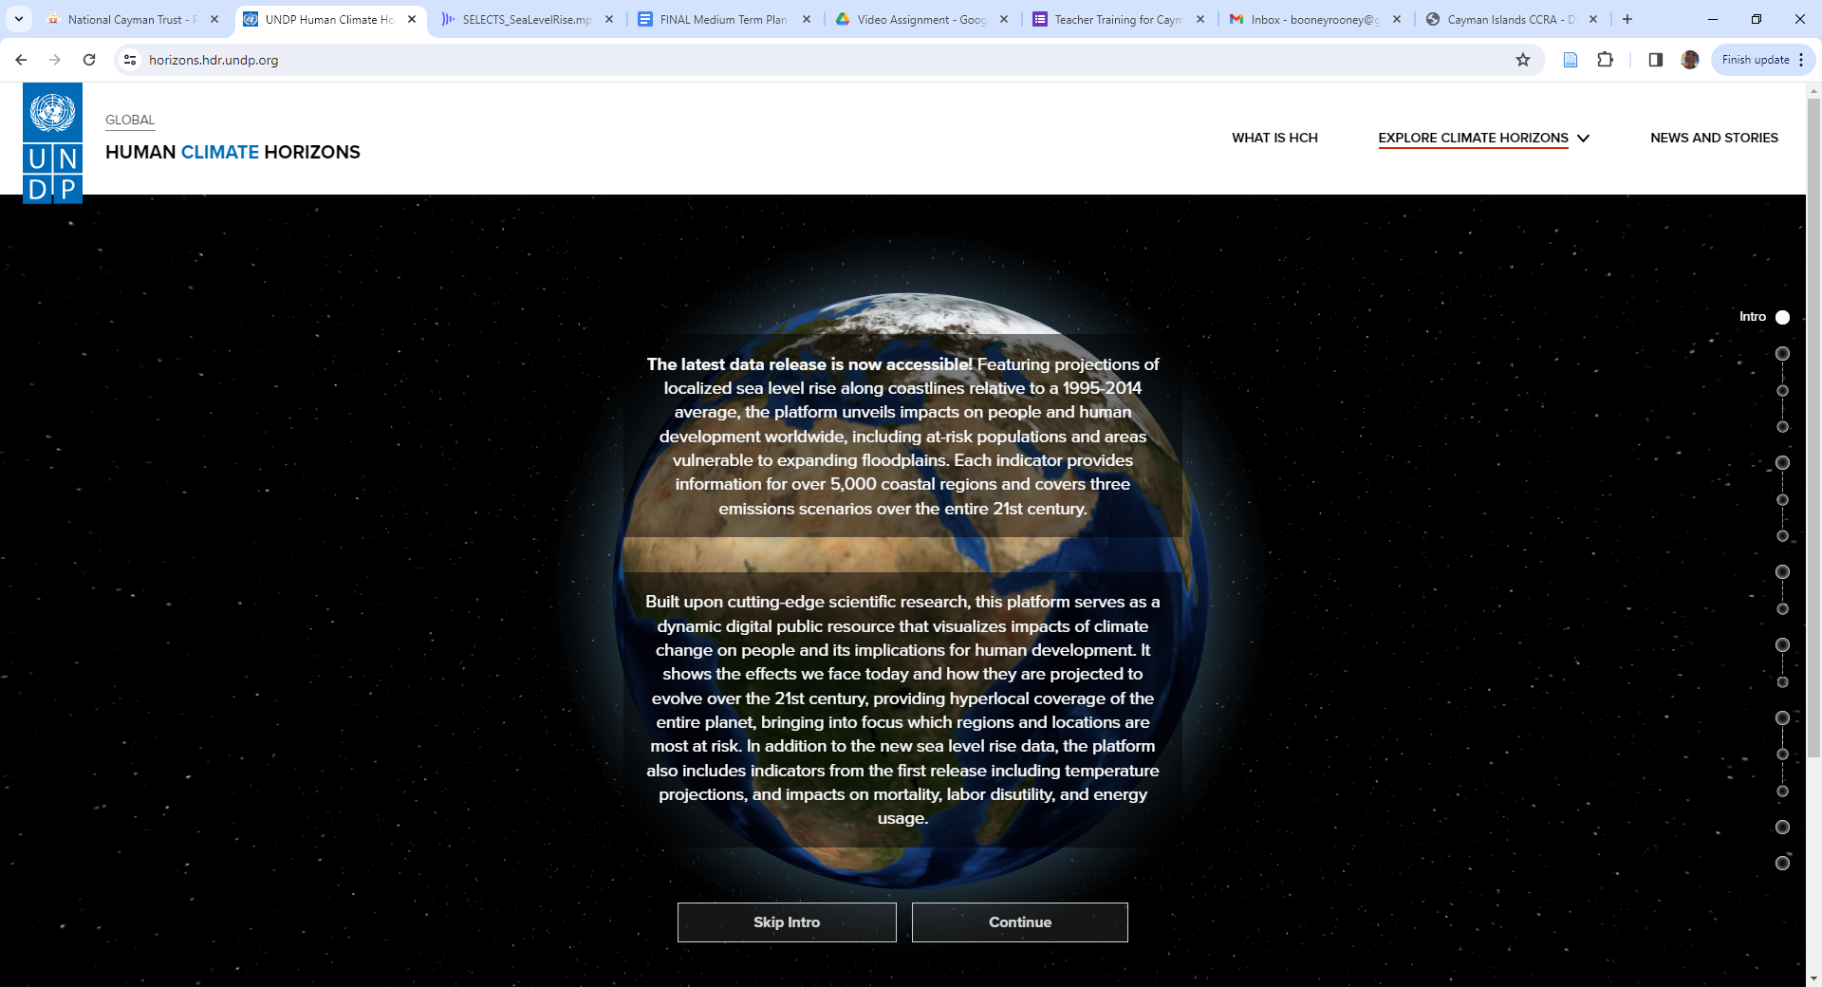
What are some of the global consequences of climate change to human life?
Human Climate Horizons webpage
Notes:
Open the Human Climate Horizons UNDP webpage and read through the slides. https://horizons.hdr.undp.org/
This webpage is based on how climate change will impact human beings and our future development. However, highlighting the impacts on the environment is the other half of picture that students must consider. Kkeep this in their minds as you read through the slides.

Slide 6
What are some of the global environmental consequences of climate change?
Extreme Weather
Rising Sea Levels
Overall Global Warming
Habitat Loss
Biodiversity Loss
Fires & Landslides
Flooding
Extreme Climates
Acidic Oceans
Extreme Ocean Temperatures
Notes:
These are some of the environmental impacts of climate change happening around the world. They also impact our health.

Slide 7
We can see that climate change impacts the entire globe, but who might be on the front lines of this threat?
Notes:
Pose the question: "Who is on the front line of climate change?" and guide them to the answer: Coastal and Island communities, like Cayman.

Slide 8
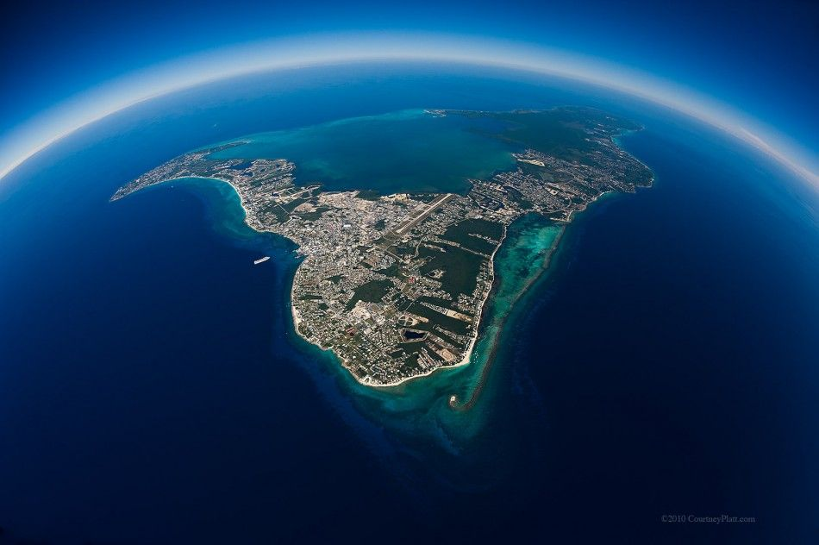
We can see that climate change impacts the entire globe, but who might be on the front lines of this threat?
Islands and coastal communities like US!
Photo credit: Courtney Platt
Notes:
Pose the question: "Who is on the front line of climate change?" and guide them to the answer: Coastal and Island communities, like Cayman.

Slide 9
Activity Time!
Let’s think more about how climate change is putting our islands at risk.
You will break into groups and each will be given a topic to consider:
Sea Level Rise
Extreme Weather
Ecosystem Disruption
Notes:
Divide class into 3 groups (or 6 if needed for class size).

Slide 10
Sea Level Rise Activity

Slide 11
Sea Level Rise Activity:
Using your activity worksheet and resources, you will create an ‘Areas at Risk of Sea Level Rise’ map of Cayman
The map should highlight areas of risk, provide relevant facts and population areas at risk!
Notes:
Talk them through the activity and then let them begin.

Slide 12
Extreme Weather Pattern Activity

Slide 13
Extreme Weather Pattern Activity
Using your activity worksheet and resources, you will create a warning poster about hurricanes and climate change for the public
The poster should show where and how hurricanes are created, the routes of hurricanes over the years and how climate change is going to impact hurricane activity.
Notes:
Talk them through the activity and then let them begin

Slide 14
Ecosystem Disruption
Activity

Slide 15
Ecosystem Disruption Activity
Using your activity worksheet and resources, you will create a ‘Ecosystems at Risk’ map
The poster should show the extent of habitats in the Cayman islands, include information on these areas and your own ideas about the importance of these places and what we can do to save and protect them.
Notes:
Talk them through the activity and then let them begin.

Slide 16
Conclusion
Notes:
Conclude with either group presentations or student gallery walk, followed by a brief class discussion about what they have learned and how these things matter on Cayman.

Slide 17
Gallery Walk & Discussion
Notes:
Conclude with either group presentations or student gallery walk, followed by a brief class discussion about what they have learned and how these things matter to Cayman.

